Slide 1
Principles of International Finance and Open Economy Macroeconomics
Cristina Terra

Slide 2
Chapter 5
The Equilibrium
Real Exchange Rate
Cristina Terra

Slide 3
Plan
The Real Exchange Rate and the Price of Nontradable Goods
Production, Consumption, and Equilibrium.
How Does the Real Exchange Rate Respond to Shocks?

Slide 4
Plan
The Real Exchange Rate and the Price of Nontradable Goods
  How to Determine the Real Exchange Rate
Production, Consumption, and Equilibrium.
How Does the Real Exchange Rate Respond to Shocks?

Slide 5
Introduction
The RER is defined as the ratio between the aggregate prices of goods from two countries, measured in the same currency.
Prices in the two countries can only diverge if there are barriers to the trade of goods between them.
There are nontradable goods: transport cost is so high in relation to price that international trade becomes impossible
We expand the intertemporal current-account model presented, dividing goods into two extreme types:
  tradable goods, with zero transportation cost and
  nontradable goods for which international trade is impossible.
In this way, the RER varies with the changes in the relative price of nontradable goods between countries.

Slide 6
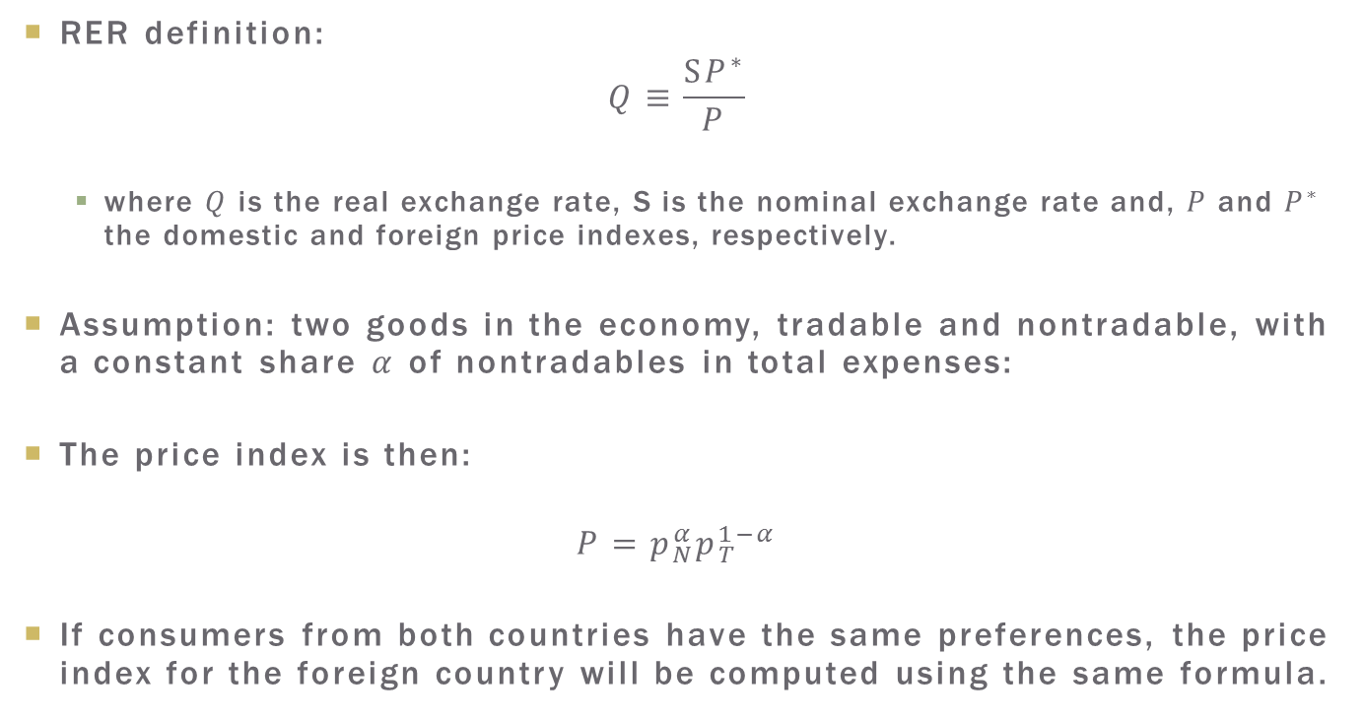
The RER and the Price of nontradable Goods
RER definition:
$$Q≡\frac{SP^{∗}}{P}$$
  where $Q$ is the real exchange rate, S is the nominal exchange rate and, $P$ and $P^{∗}$ the domestic and foreign price indexes, respectively.
Assumption: two goods in the economy, tradable and nontradable, with a constant share $α$ of nontradables in total expenses:
The price index is then:
$$P=p_{N}^{α}p_{T}^{1−α}$$
If consumers from both countries have the same preferences, the price index for the foreign country will be computed using the same formula.

Slide 7
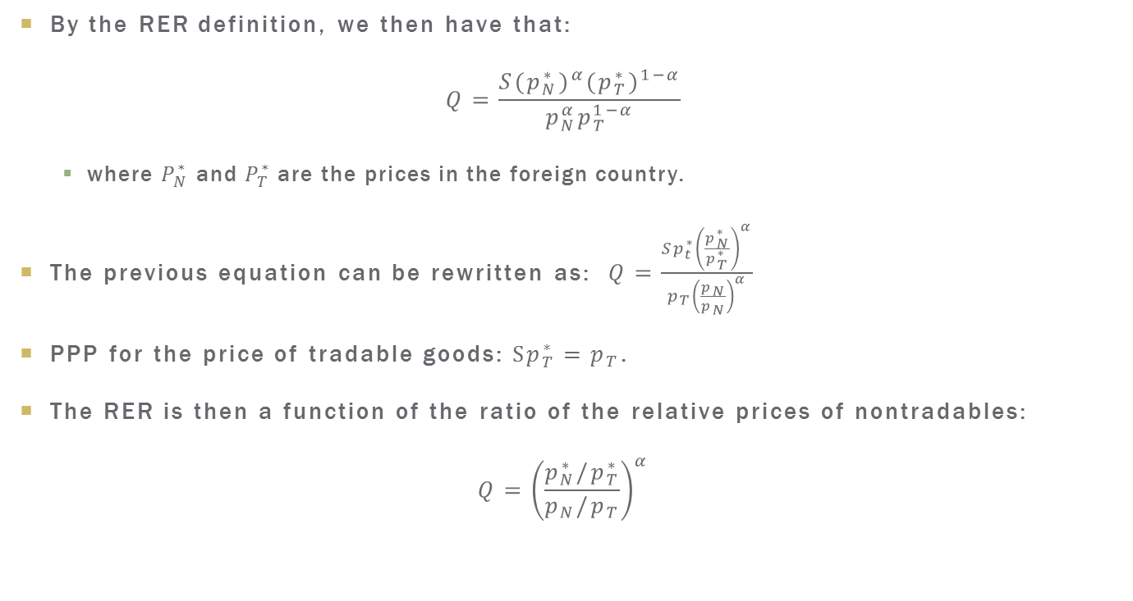
The RER and the Price of nontradable Goods
By the RER definition, we then have that:
$$Q=\frac{S(p_{N}^{∗})^{α}(p_{T}^{∗})^{1−α}}{p_{N}^{α}p_{T}^{1−α}}$$
  where $P_{N}^{∗}$ and $P_{T}^{∗}$are the prices in the foreign country.
The previous equation can be rewritten as: $Q=\frac{{Sp}_{t}^{∗}{\left(\frac{p_{N}^{∗}}{p_{T}^{∗}}\right)}^{α}}{p_{T}{\left(\frac{p_{N}}{p_{N}}\right)}^{α}}$
PPP for the price of tradable goods:$Sp_{T}^{∗}=p_{T}$.
The RER is then a function of the ratio of the relative prices of nontradables:
$$Q={\left(\frac{p_{N}^{∗}/p_{T}^{∗}}{p_{N}/p_{T}}\right)}^{α}$$

Slide 8
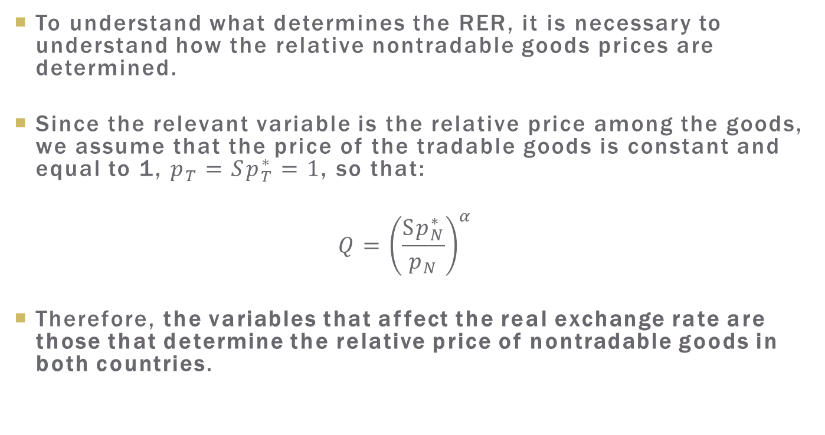
The RER and the Price of nontradable Goods
To understand what determines the RER, it is necessary to understand how the relative nontradable goods prices are determined.
Since the relevant variable is the relative price among the goods, we assume that the price of the tradable goods is constant and equal to 1, $p_{T}=Sp_{T}^{∗}=1$, so that:
$$Q={\left(\frac{Sp_{N}^{∗}}{p_{N}}\right)}^{α}$$
Therefore, the variables that affect the real exchange rate are those that determine the relative price of nontradable goods in both countries.

Slide 9
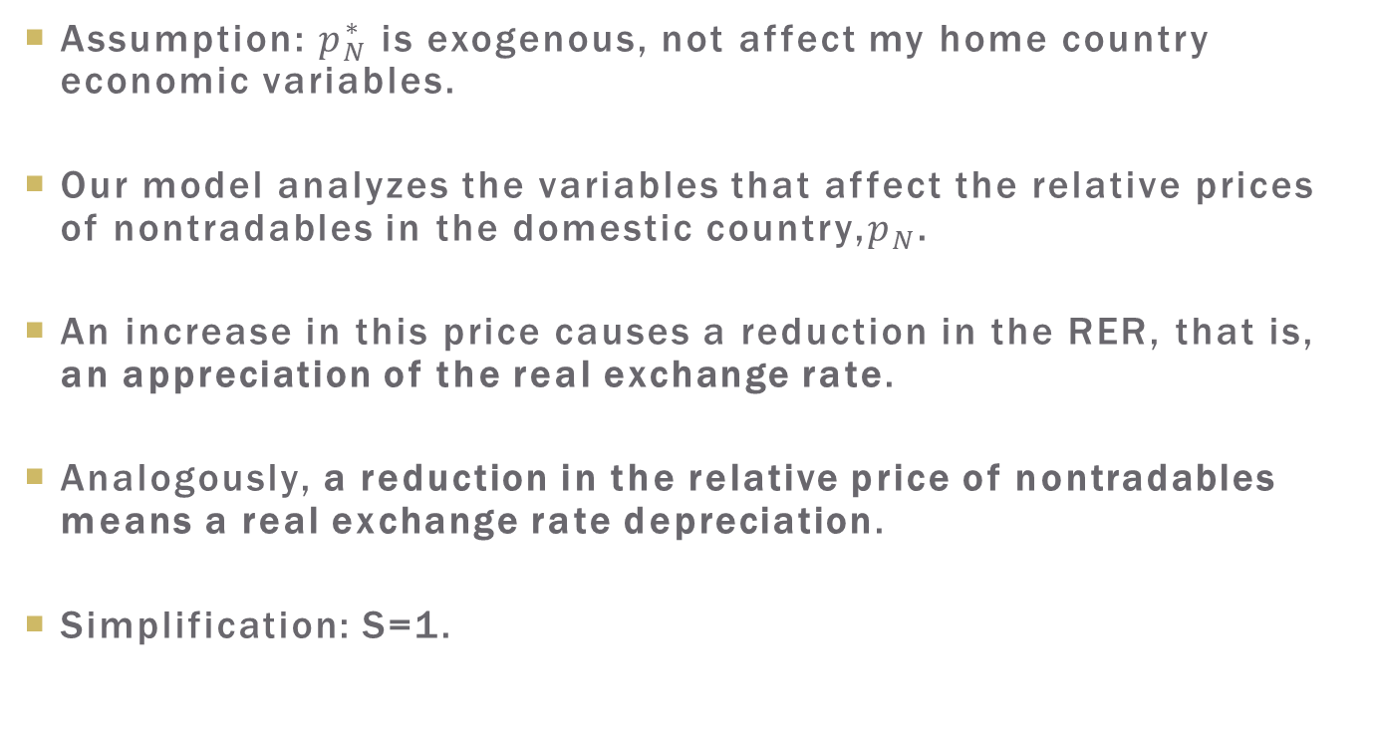
The RER and the Price of nontradable Goods
Assumption: $p_{N}^{∗}$ is exogenous, not affect my home country economic variables.
Our model analyzes the variables that affect the relative prices of nontradables in the domestic country,$p_{N}$.
An increase in this price causes a reduction in the RER, that is, an appreciation of the real exchange rate.
Analogously, a reduction in the relative price of nontradables means a real exchange rate depreciation.
Simplification: S=1.

Slide 10
How to Determine the RER
Intertemporal CA model: CA balances motivated by consumption smoothing
We use that model, with two additional massumptions:
  We add a nontradable good to that model. nontradables allows the RER to change, since the prices of these goods can be different between countries.
  Producers choose how much to produce of each type of good, given a global resources constraint.

Slide 11
Plan
The Real Exchange Rate and the Price of Nontradable Goods
Production, Consumption, and Equilibrium
  Production
  Consumption
  The Equilibrium Price
  Equilibrium Price in Autarky
  Price Index and Real Exchange Rate
  The Real Exchange Rate and the Current Account
How Does the Real Exchange Rate Respond to Shocks?

Slide 12
Production, Consumption and Equilibrium
Assumptions:
  a small, open economy
  two periods
  a population formed by a continuum of identical individuals uniformly distributed in the interval [0.1]
  two types of goods : tradables and nontradables.
  each period, each individual receives an endowment of inputs and chooses how much to produce of each type of good, given the production technology
  production determines the income that they have for each period to either consume or save

Slide 13
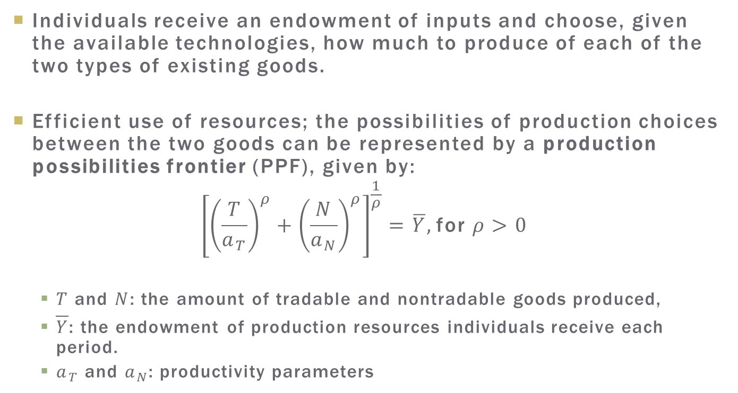
Production
Individuals receive an endowment of inputs and choose, given the available technologies, how much to produce of each of the two types of existing goods.
Efficient use of resources; the possibilities of production choices between the two goods can be represented by a production possibilities frontier (PPF), given by:
$${\left[{\left(\frac{T}{a_{T}}\right)}^{ρ}+{\left(\frac{N}{a_{N}}\right)}^{ρ}\right]}^{\frac{1}{ρ}}=\overline{Y}, \text{for} ρ>0$$
  $T$ and $N$: the amount of tradable and nontradable goods produced,
  $\overline{Y}$: the endowment of production resources individuals receive each period.
  $a_{T}$ and $a_{N}$: productivity parameters

Slide 14
Production
Hypotheses on population distribution: values for individual variables are identical to the aggregate values
  Shortcut: we will directly use the aggregate variables in the description of the individual production and consumption decisions.

Slide 15
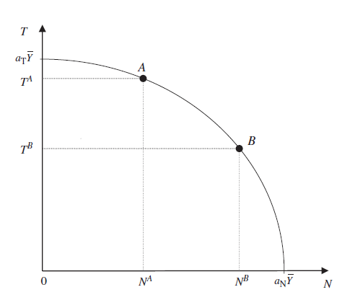

Production Possibilities Frontier
Slope = marginal rate of transformation: ${\left.\frac{dT}{dN}\right|}_{\overline{Y}}=−{\left(\frac{a_{T}}{a_{N}}\right)}^{ρ}{\left(\frac{N}{T}\right)}^{ρ−1}$.

Slide 16
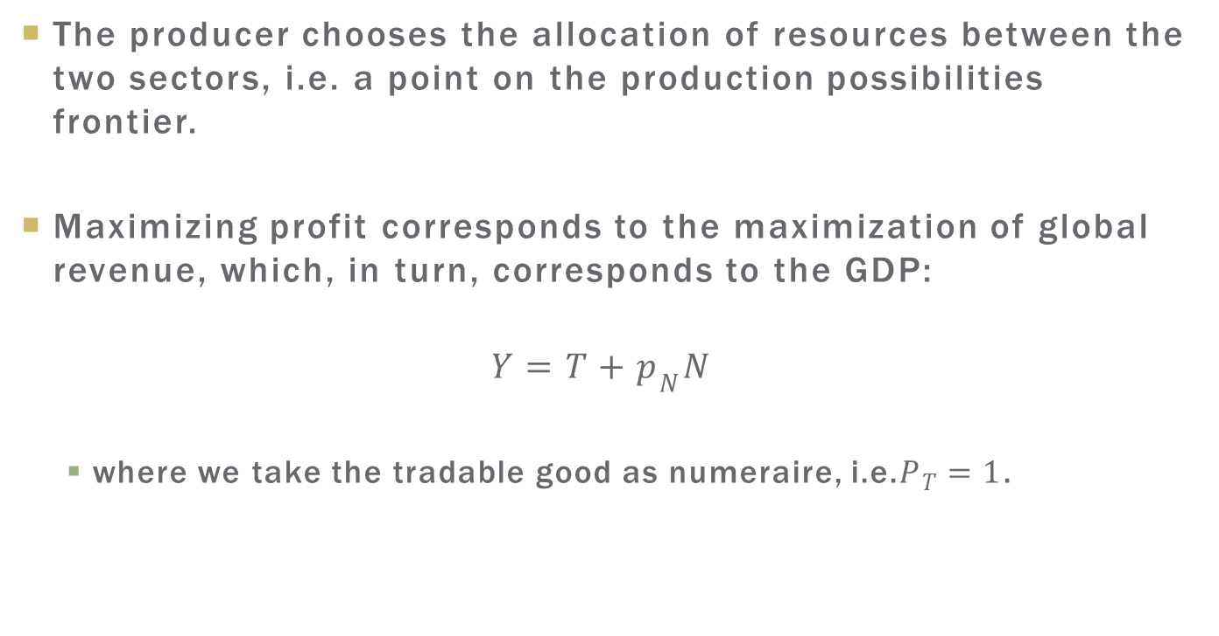
Production
The producer chooses the allocation of resources between the two sectors, i.e. a point on the production possibilities frontier.
Maximizing profit corresponds to the maximization of global revenue, which, in turn, corresponds to the GDP:
$$Y=T+p_{N}N$$
  where we take the tradable good as numeraire, i.e.$P_{T}=1$.

Slide 17
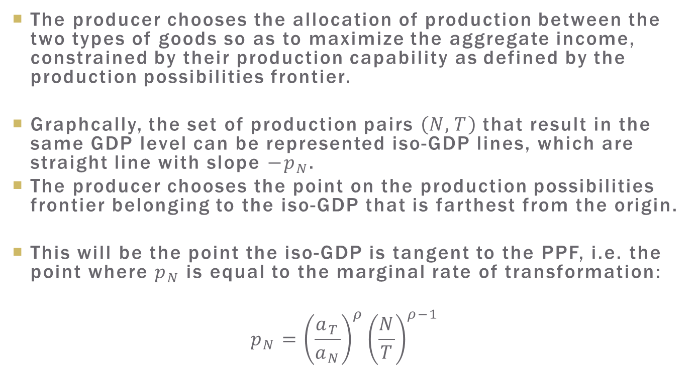
Solution to the Producer Problem
The producer chooses the allocation of production between the two types of goods so as to maximize the aggregate income, constrained by their production capability as defined by the production possibilities frontier.
Graphcally, the set of production pairs $\left(N,T\right)$ that result in the same GDP level can be represented iso-GDP lines, which are straight line with slope $−p_{N}$.
The producer chooses the point on the production possibilities frontier belonging to the iso-GDP that is farthest from the origin.
This will be the point the iso-GDP is tangent to the PPF, i.e. the point where $p_{N}$ is equal to the marginal rate of transformation:
$$p_{N}={\left(\frac{a_{T}}{a_{N}}\right)}^{ρ}{\left(\frac{N}{T}\right)}^{ρ−1}$$

Slide 18
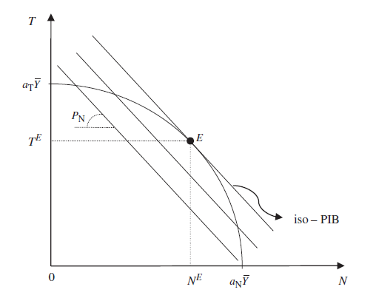
Solution to the Producer Problem

Slide 19
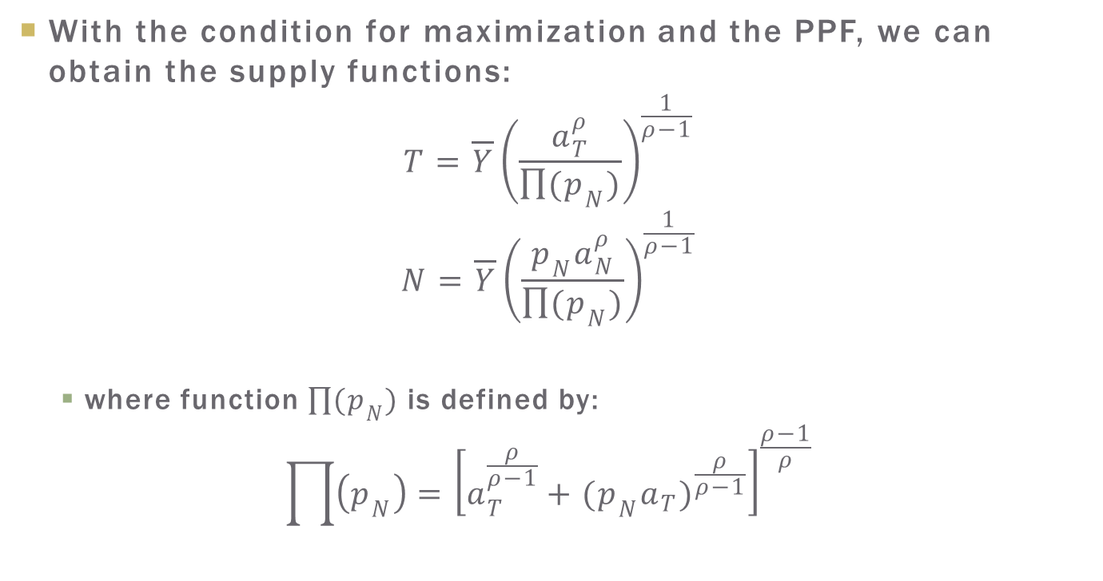
Production
With the condition for maximization and the PPF, we can obtain the supply functions:
$$T=\overline{Y}{\left(\frac{a_{T}^{ρ}}{\prod{(p_{N})}}\right)}^{\frac{1}{ρ−1}}$$
$$N=\overline{Y}{\left(\frac{p_{N}a_{N}^{ρ}}{\prod{(p_{N})}}\right)}^{\frac{1}{ρ−1}}$$
  where function $\prod{(p_{N})}$ is defined by:
$$\prod{\left(p_{N}\right)={\left[a_{T}^{\frac{ρ}{ρ−1}}+(p_{N}a_{T})^{\frac{ρ}{ρ−1}}\right]}^{\frac{ρ−1}{ρ}}}$$

Slide 20
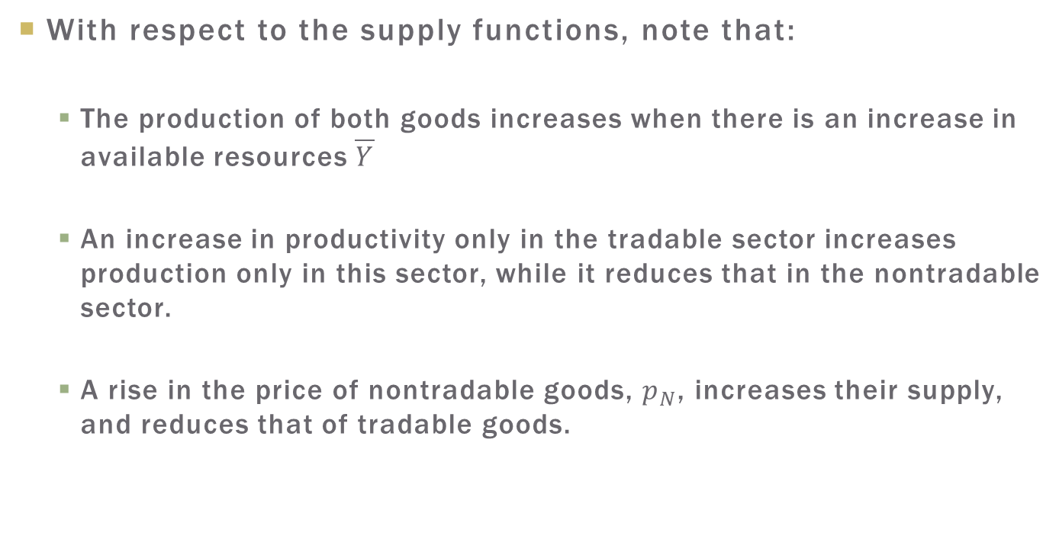
Production
With respect to the supply functions, note that:
  The production of both goods increases when there is an increase in available resources $\overline{Y}$
  An increase in productivity only in the tradable sector increases production only in this sector, while it reduces that in the nontradable sector.
  A rise in the price of nontradable goods, $p_{N}$, increases their supply, and reduces that of tradable goods.

Slide 21
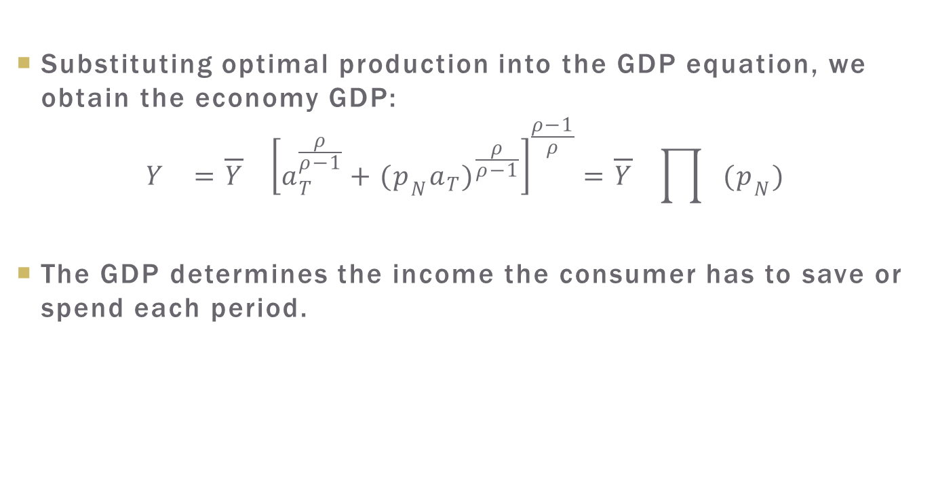
Production
Substituting optimal production into the GDP equation, we obtain the economy GDP:
$$Y_{}={\overline{Y}}_{}{\left[a_{T}^{\frac{ρ}{ρ−1}}+(p_{N}a_{T})^{\frac{ρ}{ρ−1}}\right]}^{\frac{ρ−1}{ρ}}={\overline{Y}}_{}\prod{(p_{N})}$$
The GDP determines the income the consumer has to save or spend each period.

Slide 22
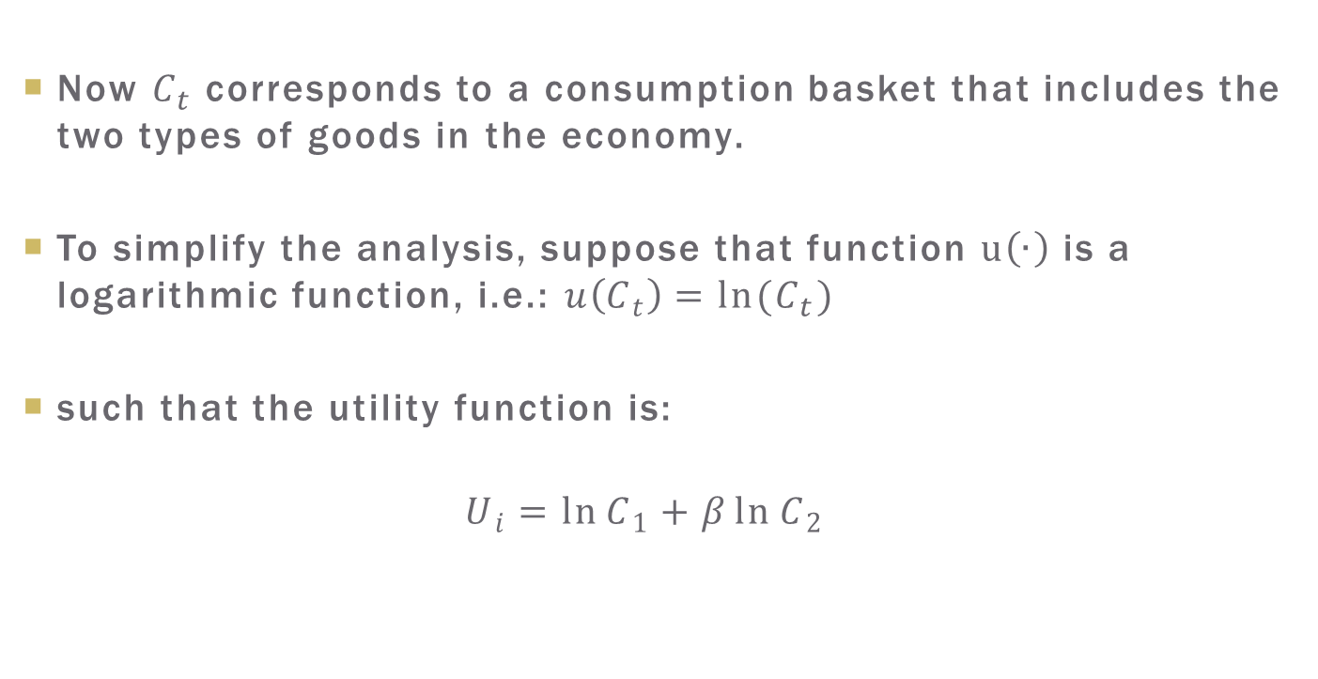
Consumption
Now $C_{t}$ corresponds to a consumption basket that includes the two types of goods in the economy.
To simplify the analysis, suppose that function $u\left(∙\right)$ is a logarithmic function, i.e.: $u\left(C_{t}\right)=ln(C_{t})$
such that the utility function is:
$$U_{i}=\ln{C_{1}}+β\ln{C_{2}}$$

Slide 23
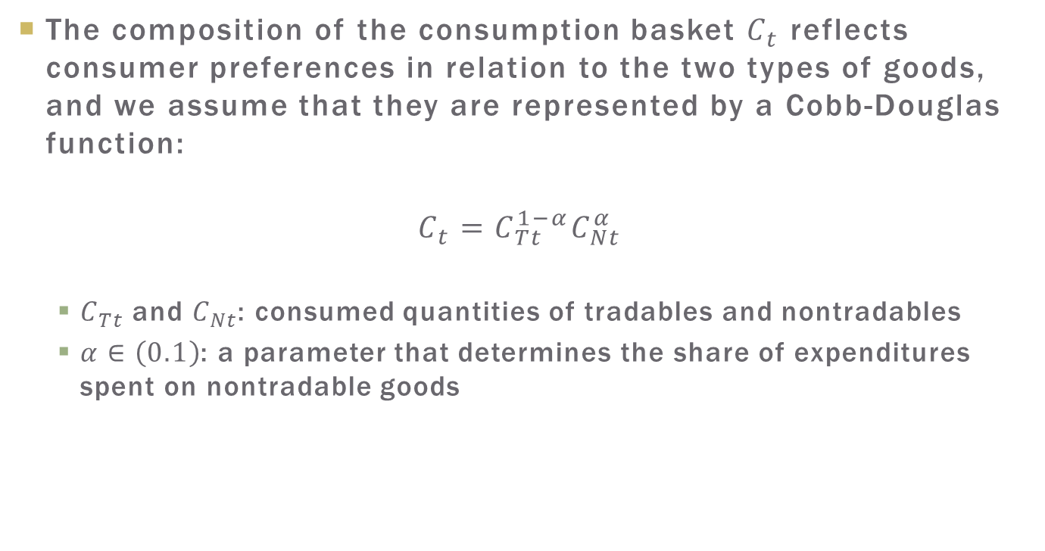
Consumption
The composition of the consumption basket $C_{t}$ reflects consumer preferences in relation to the two types of goods, and we assume that they are represented by a Cobb-Douglas function:
$$C_{t}=C_{Tt}^{1−α}C_{Nt}^{α}$$
  $C_{Tt}$ and $C_{Nt}$: consumed quantities of tradables and nontradables
  $α∈\left(0.1\right)$: a parameter that determines the share of expenditures spent on nontradable goods

Slide 24
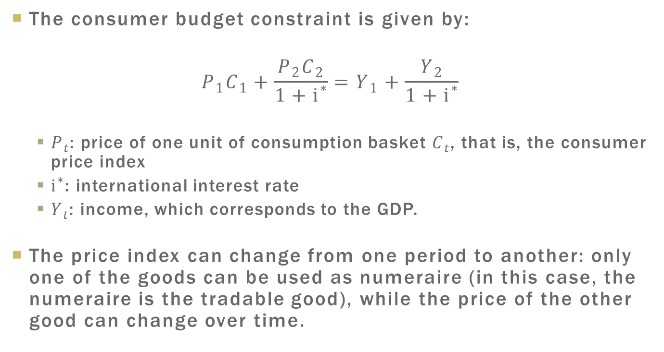
Consumer Budget Constraint
The consumer budget constraint is given by:
$$P_{1}C_{1}+\frac{P_{2}C_{2}}{1+i^{∗}}=Y_{1}+\frac{Y_{2}}{1+i^{∗}}$$
  $P_{t}$: price of one unit of consumption basket $C_{t}$, that is, the consumer price index
  $i^{∗}$: international interest rate
  $Y_{t}$: income, which corresponds to the GDP.
The price index can change from one period to another: only one of the goods can be used as numeraire (in this case, the numeraire is the tradable good), while the price of the other good can change over time.

Slide 25
Consumer Problem
With a utility function that is separable in time, the allocation of expenditures between the two goods does not affect the decision for intertemporal allocation of consumption.
This property is very convenient, for it allows us to separate the decision to consume into two decisions:
  How to allocate consumption between the two periods, and
  How to allocate total consumption for the period between the two goods.

Slide 26
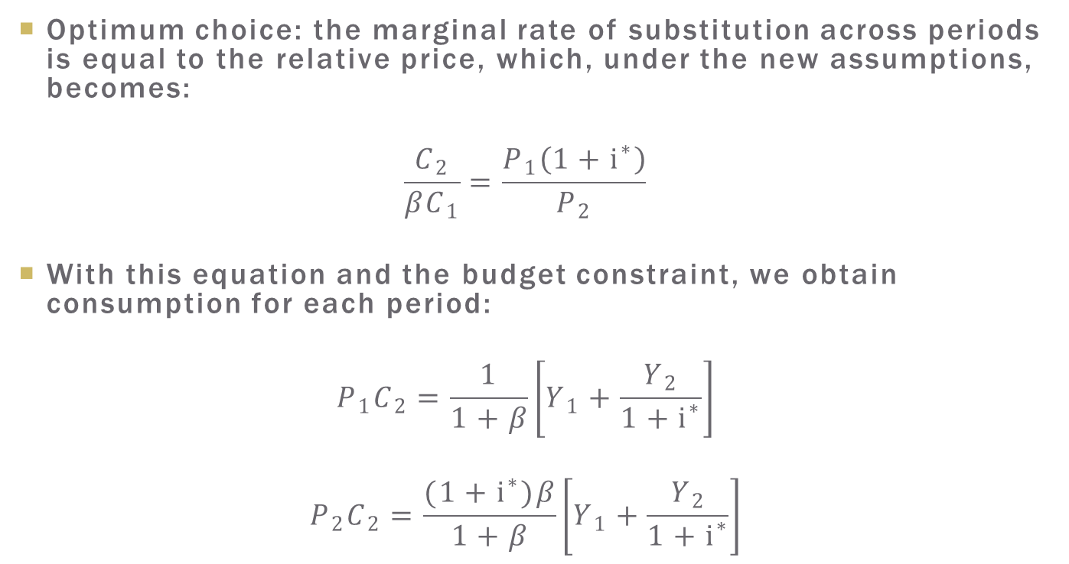
Intertemporal Consumption Allocation
Optimum choice: the marginal rate of substitution across periods is equal to the relative price, which, under the new assumptions, becomes:
$$\frac{C_{2}}{βC_{1}}=\frac{P_{1}\left(1+i^{∗}\right)}{P_{2}}$$
With this equation and the budget constraint, we obtain consumption for each period:
$$P_{1}C_{2}=\frac{1}{1+β}\left[Y_{1}+\frac{Y_{2}}{1+i^{∗}}\right]$$
$$P_{2}C_{2}=\frac{(1+i^{∗})β}{1+β}\left[Y_{1}+\frac{Y_{2}}{1+i^{∗}}\right]$$

Slide 27

Expenditure Smoothing
We have total expenditures smoothing when$β\left(1+i^{∗}\right)=1$.
In this case:
$$P_{1}C_{1}=P_{2}C_{2}=\frac{\left(1+i^{∗}\right)Y_{1}+Y_{2}}{2+i^{∗}}$$

Slide 28
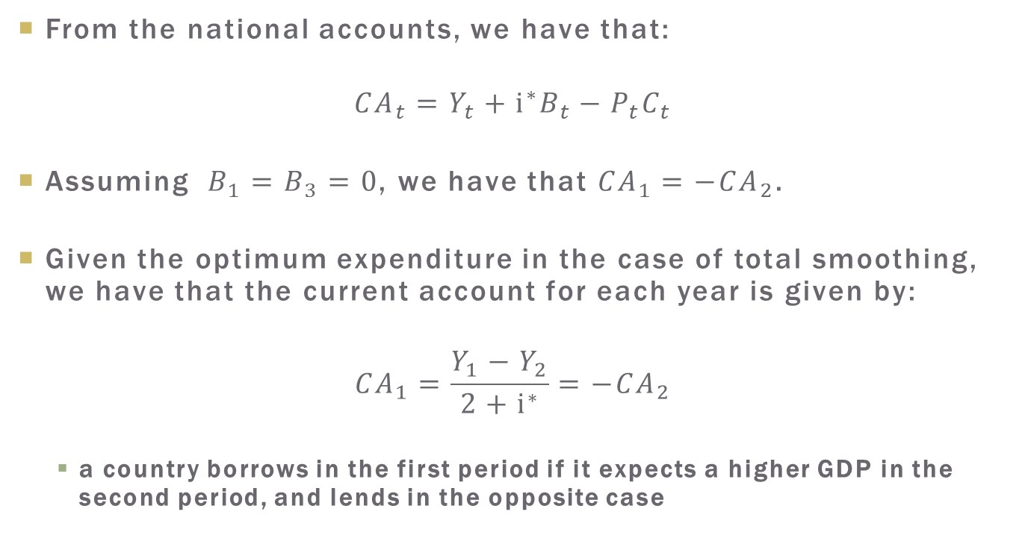
Current Account
From the national accounts, we have that:
$${CA}_{t}=Y_{t}+i^{∗}B_{t}−P_{t}C_{t}$$
Assuming $B_{1}=B_{3}=0$, we have that ${CA}_{1}=−{CA}_{2}$.
Given the optimum expenditure in the case of total smoothing, we have that the current account for each year is given by:
$${CA}_{1}=\frac{Y_{1}−Y_{2}}{2+i^{∗}}=−{CA}_{2}$$
  a country borrows in the first period if it expects a higher GDP in the second period, and lends in the opposite case

Slide 29
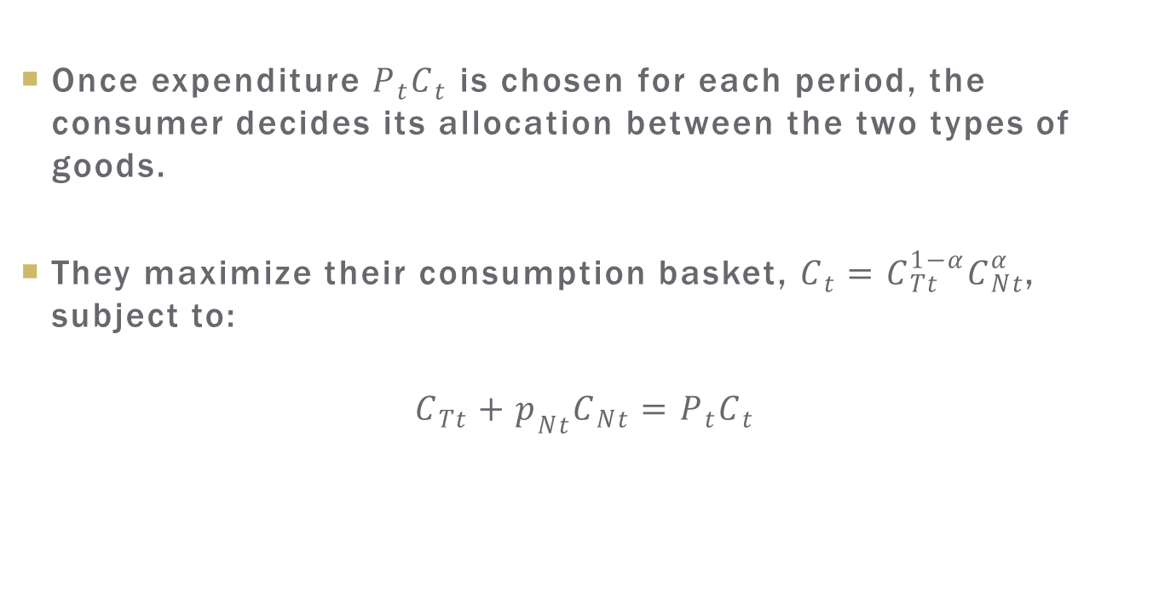
Allocation of Consumption between Tradable and nontradable Goods
Once expenditure $P_{t}C_{t}$ is chosen for each period, the consumer decides its allocation between the two types of goods.
They maximize their consumption basket, $C_{t}=C_{Tt}^{1−α}C_{Nt}^{α}$, subject to:
$$C_{Tt}+p_{Nt}C_{Nt}=P_{t}C_{t}$$

Slide 30
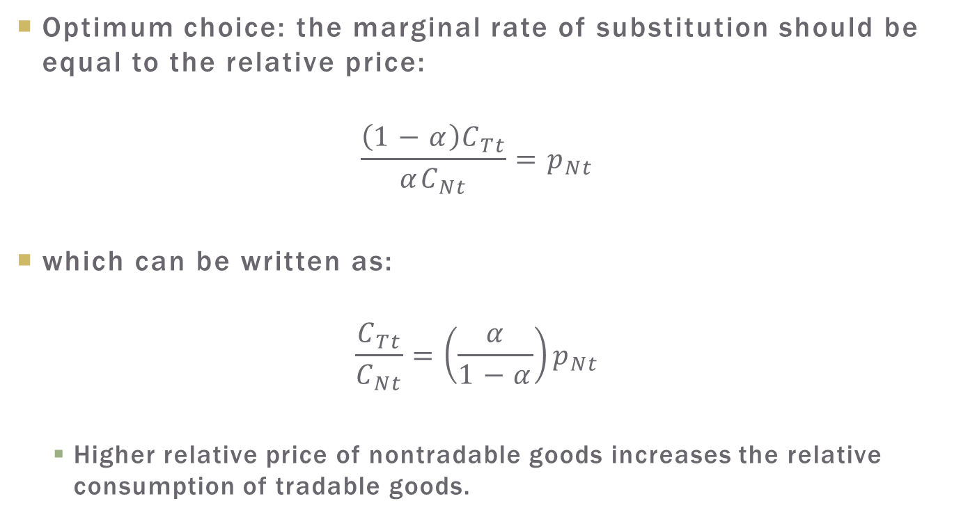
Allocation of Consumption between Tradable and nontradable Goods
Optimum choice: the marginal rate of substitution should be equal to the relative price:
$$\frac{\left(1−α\right)C_{Tt}}{αC_{Nt}}=p_{Nt}$$
which can be written as:
$$\frac{C_{Tt}}{C_{Nt}}=\left(\frac{α}{1−α}\right)p_{Nt}$$
  Higher relative price of nontradable goods increases the relative consumption of tradable goods.

Slide 31

Allocation of Consumption between Tradable and nontradable Goods
Combining the first order condition of maximization and the budget constraint, we have the demand functions:
$$C_{Tt}=(1−α)P_{t}C_{t}$$
$$p_{Nt}C_{Nt}=αP_{t}C_{t}$$

Slide 32
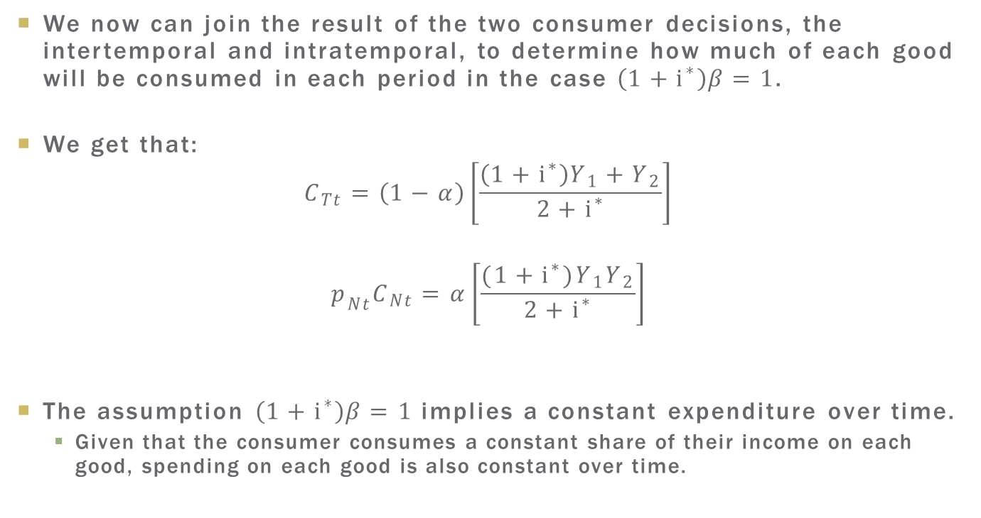
The Amount Consumed of Each Good
We now can join the result of the two consumer decisions, the intertemporal and intratemporal, to determine how much of each good will be consumed in each period in the case $\left(1+i^{∗}\right)β=1$.
We get that:
$$C_{Tt}=\left(1−α\right)\left[\frac{\left(1+i^{∗}\right)Y_{1}+Y_{2}}{2+i^{∗}}\right]$$
$$p_{Nt}C_{Nt}=α\left[\frac{(1+i^{∗})Y_{1}Y_{2}}{2+i^{∗}}\right]$$
The assumption $\left(1+i^{∗}\right)β=1$implies a constant expenditure over time.
  Given that the consumer consumes a constant share of their income on each good, spending on each good is also constant over time.

Slide 33
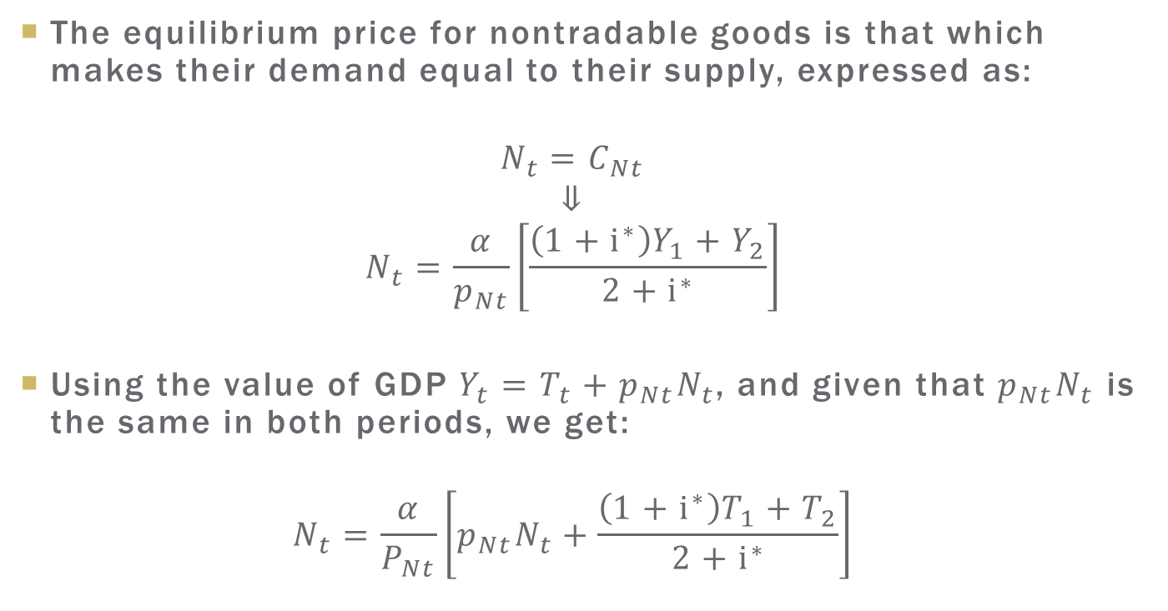
The Equilibrium Price
The equilibrium price for nontradable goods is that which makes their demand equal to their supply, expressed as:
$$N_{t}=C_{Nt}$$
$$⇓$$
$$N_{t}=\frac{α}{p_{Nt}}\left[\frac{\left(1+i^{∗}\right)Y_{1}+Y_{2}}{2+i^{∗}}\right]$$
Using the value of GDP$Y_{t}=T_{t}+p_{Nt}N_{t}$, and given that $p_{Nt}N_{t}$ is the same in both periods, we get:
$$N_{t}=\frac{α}{P_{Nt}}\left[p_{Nt}N_{t}+\frac{\left(1+i^{∗}\right)T_{1}+T_{2}}{2+i^{∗}}\right]$$

Slide 34
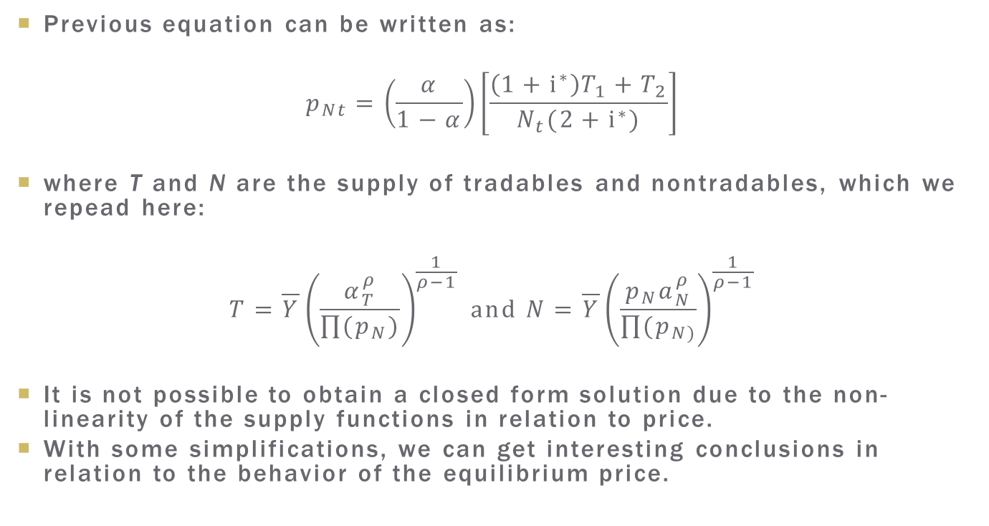
The Equilibrium Price
Previous equation can be written as:
$$p_{Nt}=\left(\frac{α}{1−α}\right)\left[\frac{\left(1+i^{∗}\right)T_{1}+T_{2}}{N_{t}(2+i^{∗})}\right]$$
where T and N are the supply of tradables and nontradables, which we repead here:
$$T=\overline{Y}{\left(\frac{α_{T}^{ρ}}{\prod{(p_{N})}}\right)}^{\frac{1}{ρ−1}} and N=\overline{Y}{\left(\frac{p_{N}a_{N}^{ρ}}{\prod{(p_{N)}}}\right)}^{\frac{1}{ρ−1}}$$
It is not possible to obtain a closed form solution due to the non-linearity of the supply functions in relation to price.
With some simplifications, we can get interesting conclusions in relation to the behavior of the equilibrium price.

Slide 35
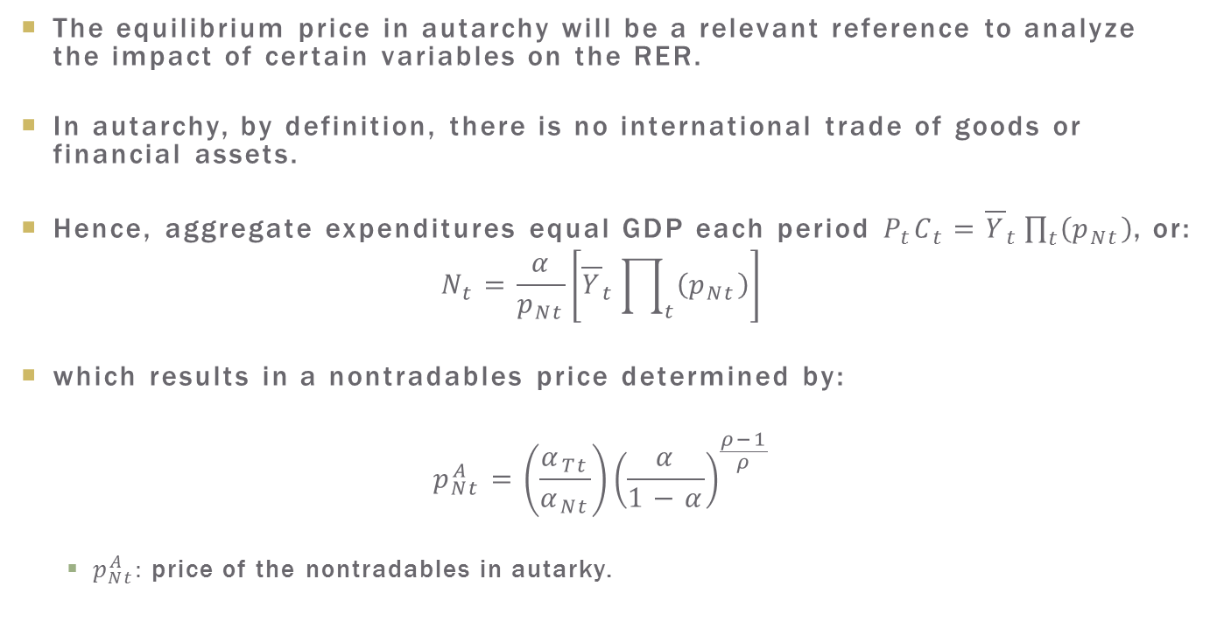
Equilibrium Price in Autarky
The equilibrium price in autarchy will be a relevant reference to analyze the impact of certain variables on the RER.
In autarchy, by definition, there is no international trade of goods or financial assets.
Hence, aggregate expenditures equal GDP each period $P_{t}C_{t}={\overline{Y}}_{t}\prod_{t}{\left(p_{Nt}\right)}$, or:
$$N_{t}=\frac{α}{p_{Nt}}\left[{\overline{Y}}_{t}\prod_{t}{\left(p_{Nt}\right)}\right]$$
which results in a nontradables price determined by:
$$p_{Nt}^{A}=\left(\frac{α_{Tt}}{α_{Nt}}\right){\left(\frac{α}{1−α}\right)}^{\frac{ρ−1}{ρ}}$$
  $p_{Nt}^{A}:$ price of the nontradables in autarky.

Slide 36
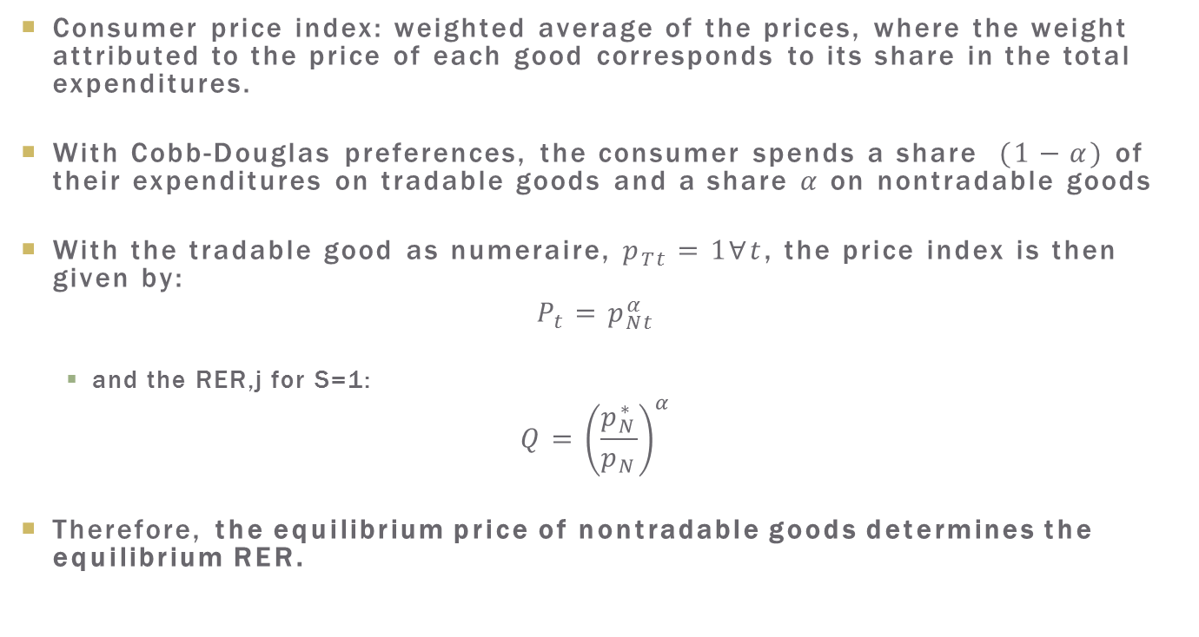
Price Index and the RER
Consumer price index: weighted average of the prices, where the weight attributed to the price of each good corresponds to its share in the total expenditures.
With Cobb-Douglas preferences, the consumer spends a share $(1−α)$ of their expenditures on tradable goods and a share $α$ on nontradable goods
With the tradable good as numeraire, $p_{Tt}=1∀t$, the price index is then given by:
$$P_{t}=p_{Nt}^{α}$$
  and the RER,j for S=1:
$$Q={\left(\frac{p_{N}^{∗}}{p_{N}}\right)}^{α}$$
Therefore, the equilibrium price of nontradable goods determines the equilibrium RER.

Slide 37
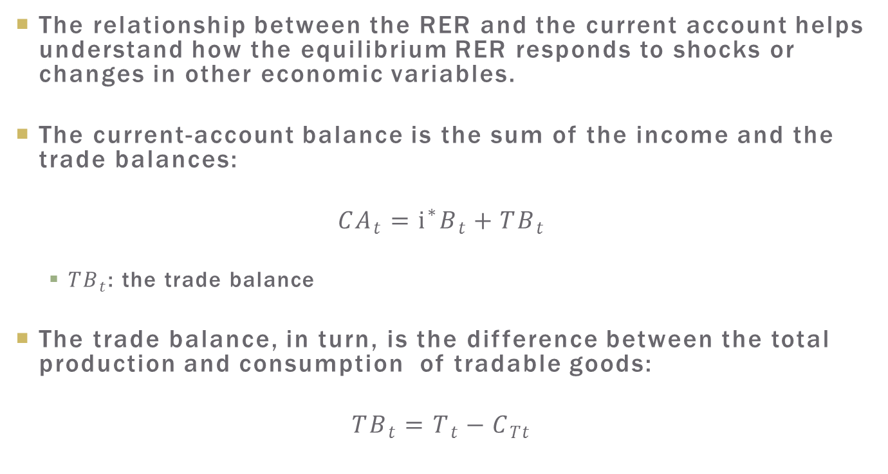
The RER and the Current Account
The relationship between the RER and the current account helps understand how the equilibrium RER responds to shocks or changes in other economic variables.
The current-account balance is the sum of the income and the trade balances:
$${CA}_{t}=i^{∗}B_{t}+{TB}_{t}$$
  ${TB}_{t}$: the trade balance
The trade balance, in turn, is the difference between the total production and consumption of tradable goods:
$${TB}_{t}=T_{t}−C_{Tt}$$

Slide 38
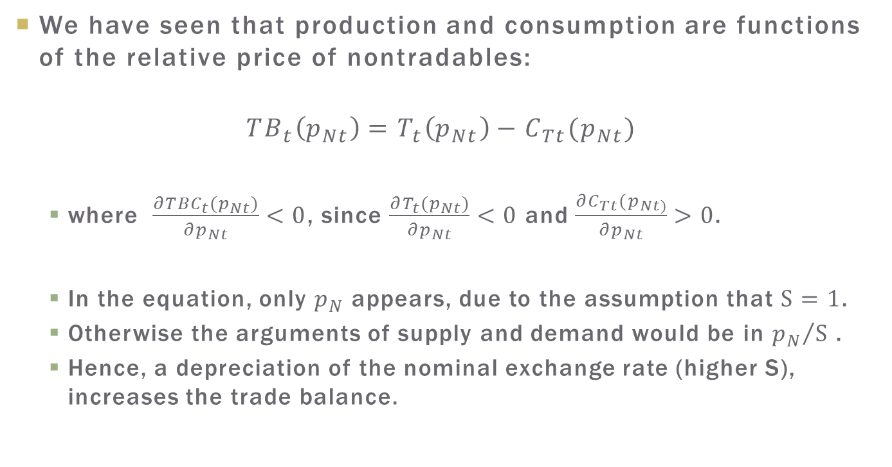
The RER and the Current Account
We have seen that production and consumption are functions of the relative price of nontradables:
$${TB}_{t}\left(p_{Nt}\right)=T_{t}\left(p_{Nt}\right)−C_{Tt}(p_{Nt})$$
  where $\frac{∂TBC_{t}(p_{Nt})}{∂p_{Nt}}<0$, since $\frac{∂T_{t}(p_{Nt})}{∂p_{Nt}}<0$ and $\frac{∂C_{Tt}(p_{Nt)}}{∂p_{Nt}}>0$.
  In the equation, only $p_{N}$ appears, due to the assumption that $S=1$.
  Otherwise the arguments of supply and demand would be in ${p_{N}}/S$ .
  Hence, a depreciation of the nominal exchange rate (higher S), increases the trade balance.

Slide 39
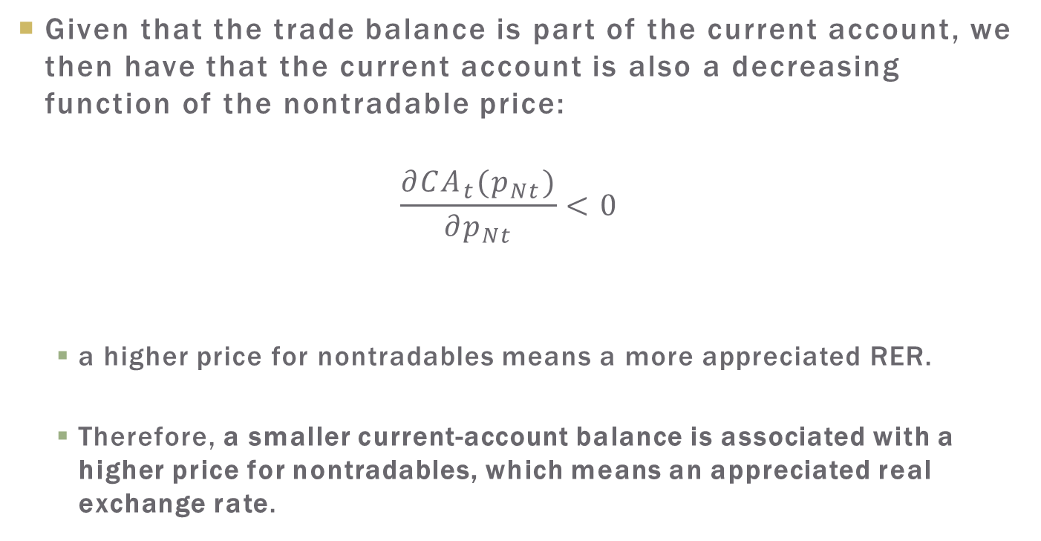
The RER and the Current Account
Given that the trade balance is part of the current account, we then have that the current account is also a decreasing function of the nontradable price:
$$\frac{{∂CA}_{t}(p_{Nt})}{{∂p}_{Nt}}<0$$
  a higher price for nontradables means a more appreciated RER.
  Therefore, a smaller current-account balance is associated with a higher price for nontradables, which means an appreciated real exchange rate.

Slide 40
Plan
The Real Exchange Rate and the Price of Nontradable Goods
Production, Consumption, and Equilibrium.
How Does the Real Exchange Rate Respond to Shocks?
  Income Shock
  Impact of an Exogenous Reduction in Financial Flows
  Increase in International Interest Rates
  The Impact of Government Spending
  Differences in Productivity: The Balassa-Samuelson Effect
  Terms of Trade

Slide 41
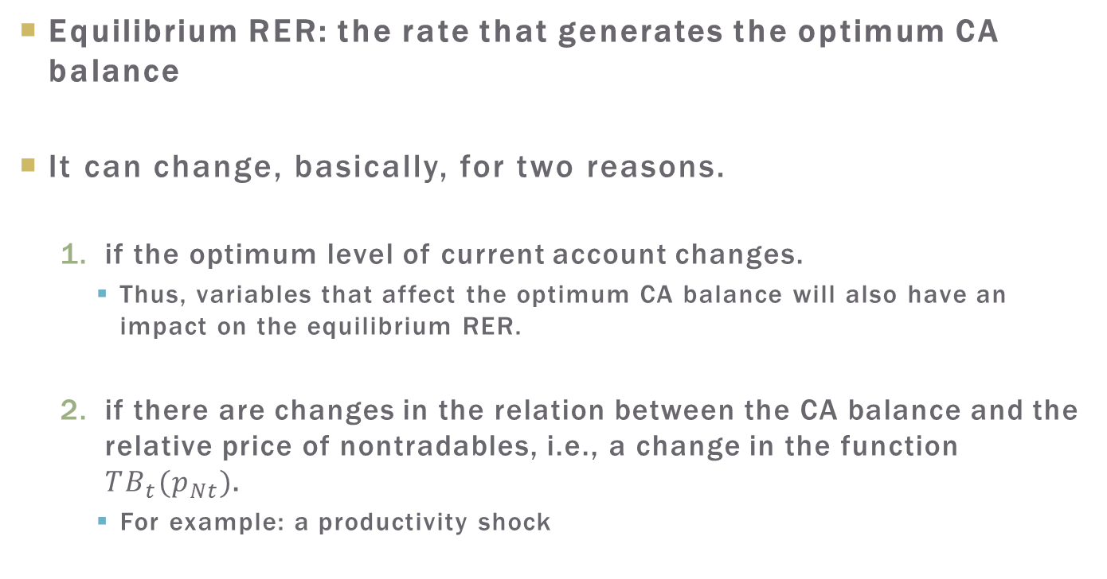
The RER and the Current Account
Equilibrium RER: the rate that generates the optimum CA balance
It can change, basically, for two reasons.
  if the optimum level of current account changes.
    Thus, variables that affect the optimum CA balance will also have an impact on the equilibrium RER.
  if there are changes in the relation between the CA balance and the relative price of nontradables, i.e., a change in the function ${TB}_{t}(p_{Nt})$.
    For example: a productivity shock

Slide 42
Shocks and the RER:
Income shock
Intuition:
  Permanent income shocks do not have an impact on current account, while a temporary positive shock would have a positive impact on current account.
  Hence, a permanent income shock would not affect the equilibrium RER, while a temporary increase in income should cause a depreciation of the RER.
Let us see what the model tells us.

Slide 43
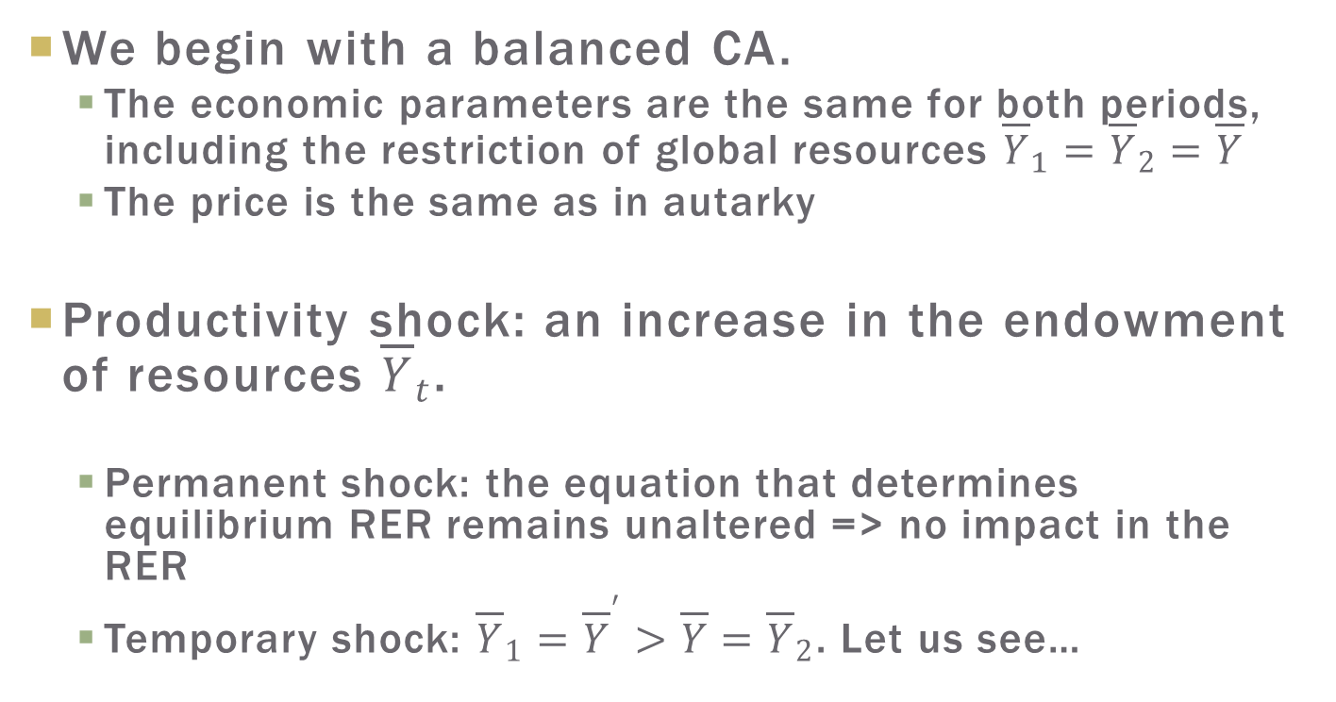
Shocks and the RER:
Income shock
We begin with a balanced CA.
  The economic parameters are the same for both periods, including the restriction of global resources ${\overline{Y}}_{1}={\overline{Y}}_{2}=\overline{Y}$
  The price is the same as in autarky
Productivity shock: an increase in the endowment of resources ${\overline{Y}}_{t}$.
  Permanent shock: the equation that determines equilibrium RER remains unaltered => no impact in the RER
  Temporary shock: ${\overline{Y}}_{1}={{\overline{Y}}^{′}>\overline{Y}=\overline{Y}}_{2}$. Let us see…

Slide 44
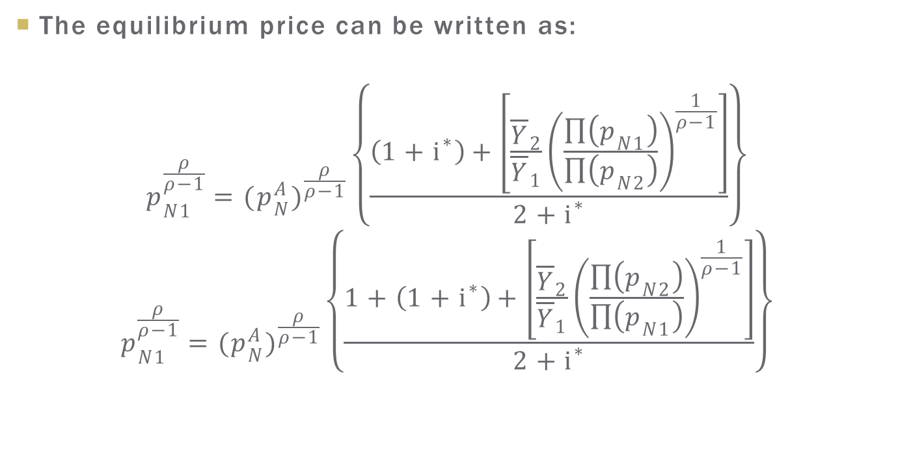
Shocks and the RER:
Income shock
The equilibrium price can be written as:
$$p_{N1}^{\frac{ρ}{ρ−1}}=(p_{N}^{A})^{\frac{ρ}{ρ−1}}\left\{\frac{\left(1+i^{∗}\right)+\left[\frac{{\overline{Y}}_{2}}{{\overline{Y}}_{1}}{\left(\frac{\prod{\left(p_{N1}\right)}}{\prod{\left(p_{N2}\right)}}\right)}^{\frac{1}{ρ−1}}\right]}{2+i^{∗}}\right\}$$
$$p_{N1}^{\frac{ρ}{ρ−1}}=(p_{N}^{A})^{\frac{ρ}{ρ−1}}\left\{\frac{1+\left(1+i^{∗}\right)+\left[\frac{{\overline{Y}}_{2}}{{\overline{Y}}_{1}}{\left(\frac{\prod{\left(p_{N2}\right)}}{\prod{\left(p_{N1}\right)}}\right)}^{\frac{1}{ρ−1}}\right]}{2+i^{∗}}\right\}$$

Slide 45
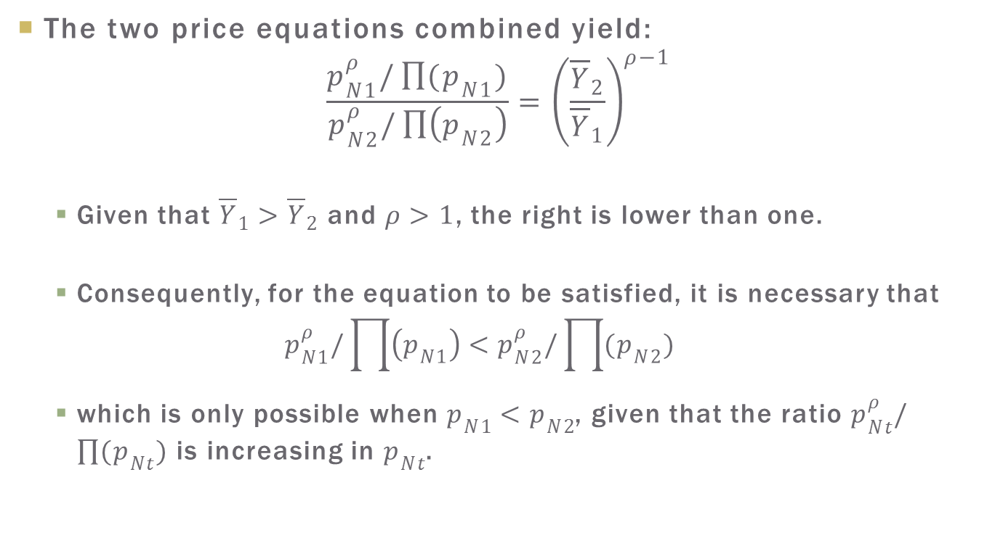
Shocks and the RER:
Income shock
The two price equations combined yield:
$$\frac{p_{N1}^{ρ}/\prod{(p_{N1})}}{p_{N2}^{ρ}/\prod{\left(p_{N2}\right)}}={\left(\frac{{\overline{Y}}_{2}}{{\overline{Y}}_{1}}\right)}^{ρ−1}$$
  Given that ${\overline{Y}}_{1}>{\overline{Y}}_{2}$ and$ρ>1$, the right is lower than one.
  Consequently, for the equation to be satisfied, it is necessary that
  $$p_{N1}^{ρ}/\prod{\left(p_{N1}\right)<p_{N2}^{ρ}/\prod{(p_{N2})}}$$
  which is only possible when $p_{N1}<p_{N2}$, given that the ratio $p_{Nt}^{ρ}/\prod{(p_{Nt})}$ is increasing in $p_{Nt}$.

Slide 46
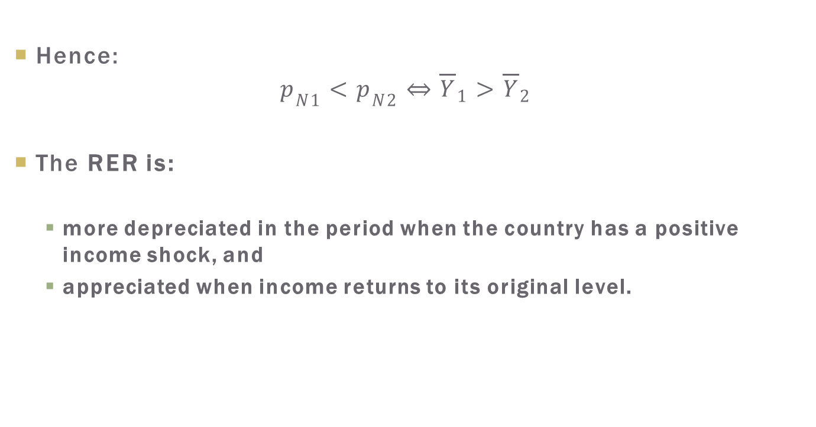
Shocks and the RER:
Income shock
Hence:
$$p_{N1}<p_{N2}⇔{\overline{Y}}_{1}>{\overline{Y}}_{2}$$
The RER is:
  more depreciated in the period when the country has a positive income shock, and
  appreciated when income returns to its original level.

Slide 47
Shocks and the RER:
Income shock
Intuition:
  Access to the international credit market allows consumers to smooth their consumption.
  If the relative price of nontradables were the same for both periods, there would be an excess supply of these goods in the first period, when the economy has relatively more production resources.
  A smaller price for nontradable goods in the first period would simultaneously decreases production of nontradables and increases their demand, balancing the market.

Slide 48
Shocks and the RER:
Income shock
On the tradables market, the cheapening of non-tradables would cause
  a reduction in demand for tradables and
  an increase in their supply.
  Thus, an increase in the current-account balance.
The result is in keeping with our initial intuition:
  a permanent income shock does not affect the optimum current-account level, thus the equilibrium RER remains unaltered;
  whereas a temporary positive income shock leads to an increase in current-account balance, accompanied by a depreciation of the real exchange rate.

Slide 49
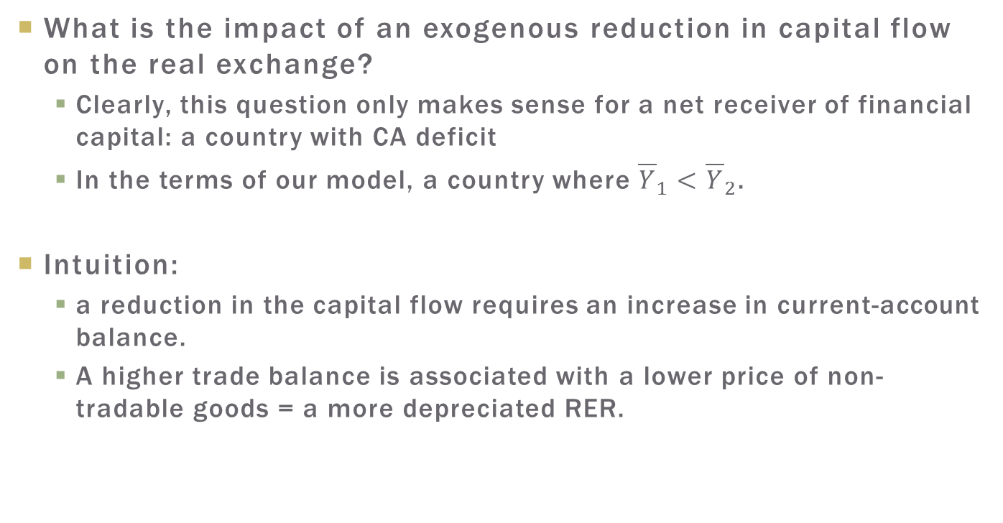
Reduction in Financial Flows
What is the impact of an exogenous reduction in capital flow on the real exchange?
  Clearly, this question only makes sense for a net receiver of financial capital: a country with CA deficit
  In the terms of our model, a country where ${\overline{Y}}_{1}<{\overline{Y}}_{2}$.
Intuition:
  a reduction in the capital flow requires an increase in current-account balance.
  A higher trade balance is associated with a lower price of non-tradable goods = a more depreciated RER.

Slide 50
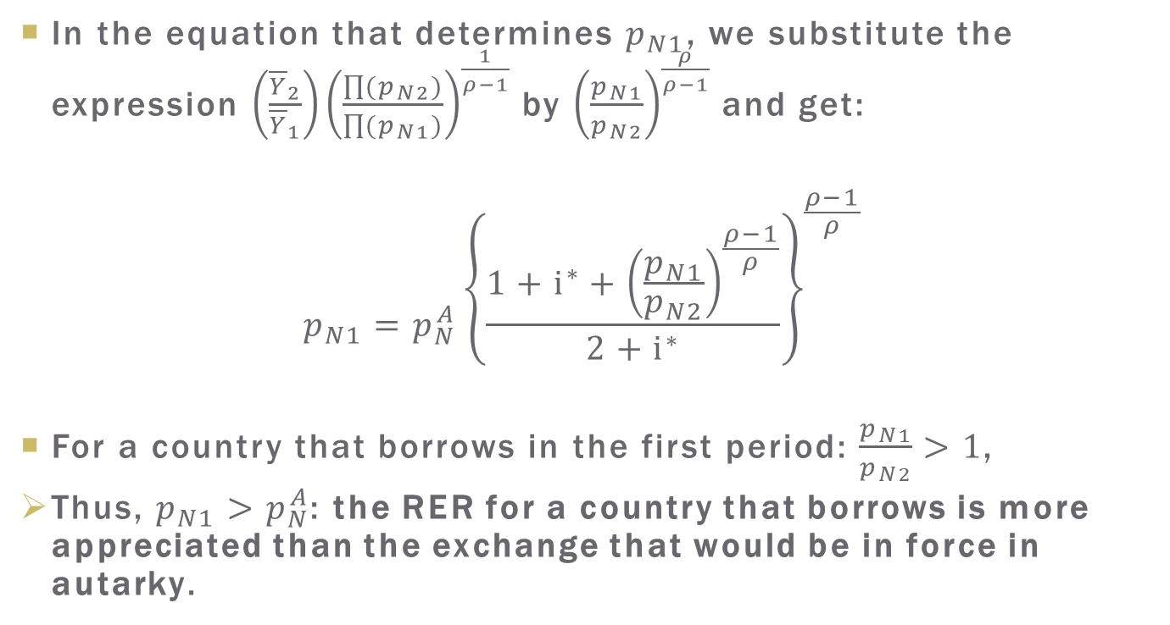
Reduction in Financial Flows
In the equation that determines $p_{N1}$, we substitute the expression $\left(\frac{{\overline{Y}}_{2}}{{\overline{Y}}_{1}}\right){\left(\frac{\prod{(p_{N2})}}{\prod{(p_{N1})}}\right)}^{\frac{1}{ρ−1}}$ by ${\left(\frac{p_{N1}}{p_{N2}}\right)}^{\frac{ρ}{ρ−1}}$ and get:
$$p_{N1}=p_{N}^{A}{\left\{\frac{1+i^{∗}+{\left(\frac{p_{N1}}{p_{N2}}\right)}^{\frac{ρ−1}{ρ}}}{2+i^{∗}}\right\}}^{\frac{ρ−1}{ρ}}$$
For a country that borrows in the first period: $\frac{p_{N1}}{p_{N2}}>1$,
Thus, $p_{N1}>p_{N}^{A}$: the RER for a country that borrows is more appreciated than the exchange that would be in force in autarky.

Slide 51
Reduction in Financial Flows
What is the impact of an exogenous reduction of capital flow?
  In an extreme case of a total stop of capital flow: the price of non-tradables would go to its value in autarky, which entails a depreciation of the real exchange rate.
  When the capital flow just decreases, without stopping completely, there will be a depreciation of the real exchange, even if in a relatively smaller magnitude.
  Consequently, an exogenous reduction in the flow of capital results in a depreciation of the RER.

Slide 52
Increase in Interest Rates
What is the impact of an increase in international interest rates on the real exchange?
Intuition:
  We have seen that the interest rate affects consumption by means of two distinct effects: a substitution effect and an income effect.
    Substitution effect: a positive effect on the CA in the first period.
    Income effect:
      negative for a borrower country
      positive for a lender country

Slide 53
Increase in Interest Rates
For a borrower country:
  Both income and substitution effects lead to a reduction in consumption => lower CA balance => RER depreciation
For a lender country:
  The income and the substitution effects lead in opposite directions.
  We will see that, with complete consumption smoothing, the income effect surpasses the substitution effect, entailing an increase in the CA balance => appreciation of the RER.

Slide 54
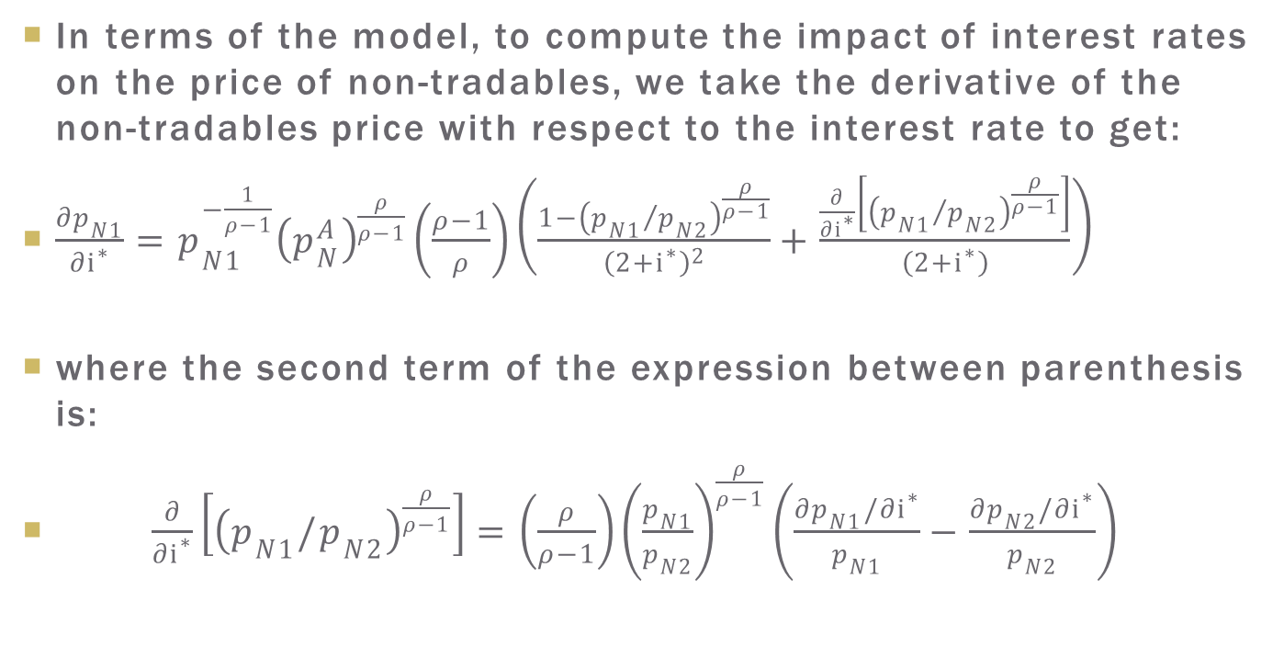
Increase in Interest Rates
In terms of the model, to compute the impact of interest rates on the price of non-tradables, we take the derivative of the non-tradables price with respect to the interest rate to get:
$\frac{∂p_{N1}}{∂i^{∗}}=p_{N1}^{−\frac{1}{ρ−1}}{\left(p_{N}^{A}\right)}^{\frac{ρ}{ρ−1}}\left(\frac{ρ−1}{ρ}\right)\left(\frac{1−{\left({p_{N1}}/{p_{N2}}\right)}^{\frac{ρ}{ρ−1}}}{{\left(2+i^{∗}\right)}^{2}}+\frac{\frac{∂}{∂i^{∗}}\left[{\left({p_{N1}}/{p_{N2}}\right)}^{\frac{ρ}{ρ−1}}\right]}{\left(2+i^{∗}\right)}\right)$
where the second term of the expression between parenthesis is:
$\frac{∂}{{∂i}^{∗}}\left[{\left(p_{N1}/p_{N2}\right)}^{\frac{ρ}{ρ−1}}\right]=\left(\frac{ρ}{ρ−1}\right){\left(\frac{p_{N1}}{p_{N2}}\right)}^{\frac{ρ}{ρ−1}}\left(\frac{∂p_{N1}/{∂i}^{∗}}{p_{N1}}−\frac{∂p_{N2}/{∂i}^{∗}}{p_{N2}}\right)$

Slide 55
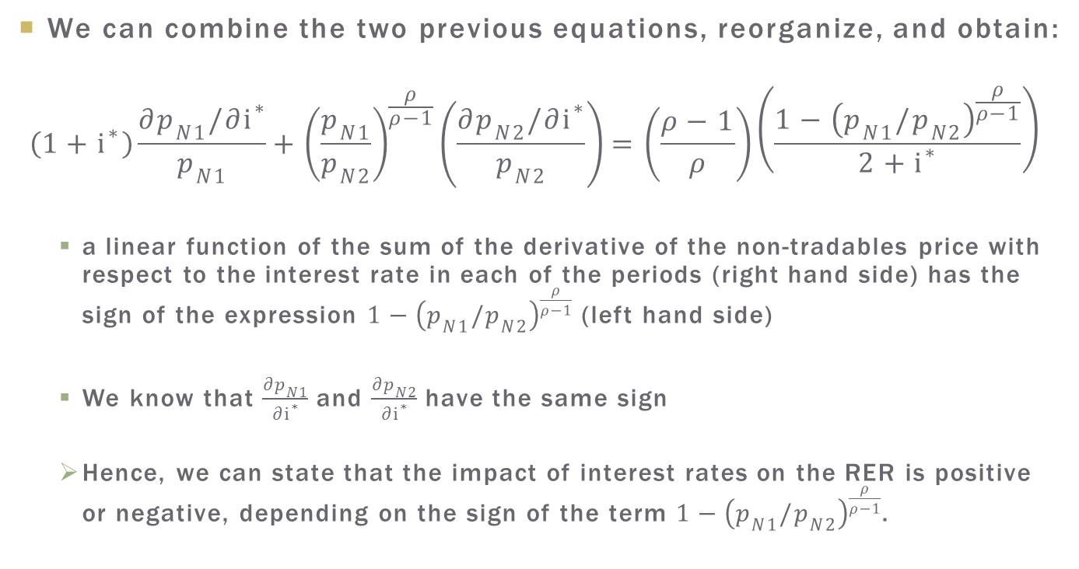
Increase in Interest rates
We can combine the two previous equations, reorganize, and obtain:
$$\left(1+i^{∗}\right)\frac{{∂p}_{N1}/{∂i}^{∗}}{p_{N1}}+{\left(\frac{p_{N1}}{p_{N2}}\right)}^{\frac{ρ}{ρ−1}}\left(\frac{{∂p}_{N2}/{∂i}^{∗}}{p_{N2}}\right)=\left(\frac{ρ−1}{ρ}\right)\left(\frac{1−{\left(p_{N1}/p_{N2}\right)}^{\frac{ρ}{ρ−1}}}{2+i^{∗}}\right)$$
  a linear function of the sum of the derivative of the non-tradables price with respect to the interest rate in each of the periods (right hand side) has the sign of the expression $1−{\left(p_{N1}/p_{N2}\right)}^{\frac{ρ}{ρ−1}}$ (left hand side)
  We know that $\frac{∂p_{N1}}{∂i^{∗}}$ and $\frac{∂p_{N2}}{∂i^{∗}}$ have the same sign
  Hence, we can state that the impact of interest rates on the RER is positive or negative, depending on the sign of the term$1−{\left(p_{N1}/p_{N2}\right)}^{\frac{ρ}{ρ−1}}$.

Slide 56
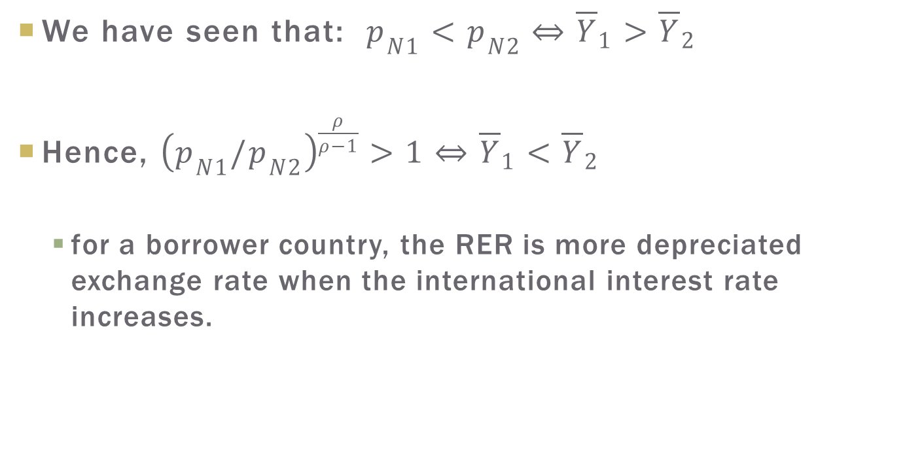
Increase in Interest rates
We have seen that: $p_{N1}<p_{N2}⇔{\overline{Y}}_{1}>{\overline{Y}}_{2}$
Hence, ${\left(p_{N1}/p_{N2}\right)}^{\frac{ρ}{ρ−1}}>1⇔{\overline{Y}}_{1}<{\overline{Y}}_{2}$
  for a borrower country, the RER is more depreciated exchange rate when the international interest rate increases.

Slide 57
Increase in Interest rates
Intuition:
  Indebted country: higher interest rates = higher debt service = lower disposable income
  => lower consumption, particularly of nontradables
  => excess supply of nontradables
  => higher price of nontradables to de-stimulate production in that sector and balance the market
  The consequent RER depreciation also de-stimulates imports: higher CA balance

Slide 58
Increase in Government Spending
Government spending is commonly pointed out as an important variable in determining the equilibrium RER.
Before the algebra, let us look at the intuition.
Government spending intertemporal effect:
  We have seen different levels of government spending across periods have an impact on the aggregate expenditures:
  Higher public spending in the first period in relation to the second, for example, reduces the CA in the first period.
  Changes in the CA balance impact the equilibrium RER, given the negative relation between the two variables
Only temporary changes in public spending have an effect on the RER by the intertemporal effect.

Slide 59
Increase in Government Spending
Government spending composition effect:
  This effect is associated with the composition of public spending between tradable and non-tradable goods.
  Relative price of non-tradable goods: the equilibrium between the supply and demand of these goods.
    On one hand, government spending reduces private consumption given that the taxes imposed to finance them reduce consumer disposable income.
    On the other, public consumption is added to aggregate expenditures.
  Public spending will have an effect on the RER when its composition between the two types of goods differs from the composition of private spending.

Slide 60
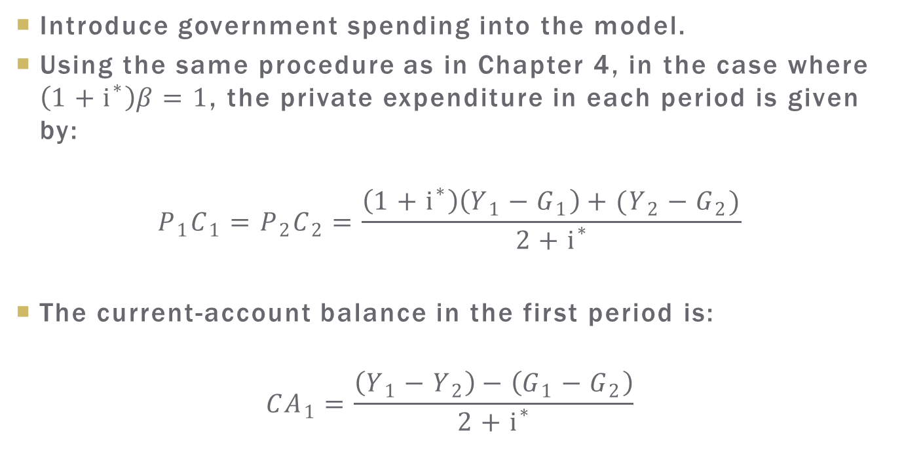
Increase in Government Spending
Introduce government spending into the model.
Using the same procedure as in Chapter 4, in the case where $\left(1+i^{∗}\right)β=1$, the private expenditure in each period is given by:
$$P_{1}C_{1}=P_{2}C_{2}=\frac{\left(1+i^{∗}\right)\left(Y_{1}−G_{1}\right)+(Y_{2}−G_{2})}{2+i^{∗}}$$
The current-account balance in the first period is:
$${CA}_{1}=\frac{\left(Y_{1}−Y_{2}\right)−\left(G_{1}−G_{2}\right)}{2+i^{∗}}$$

Slide 61
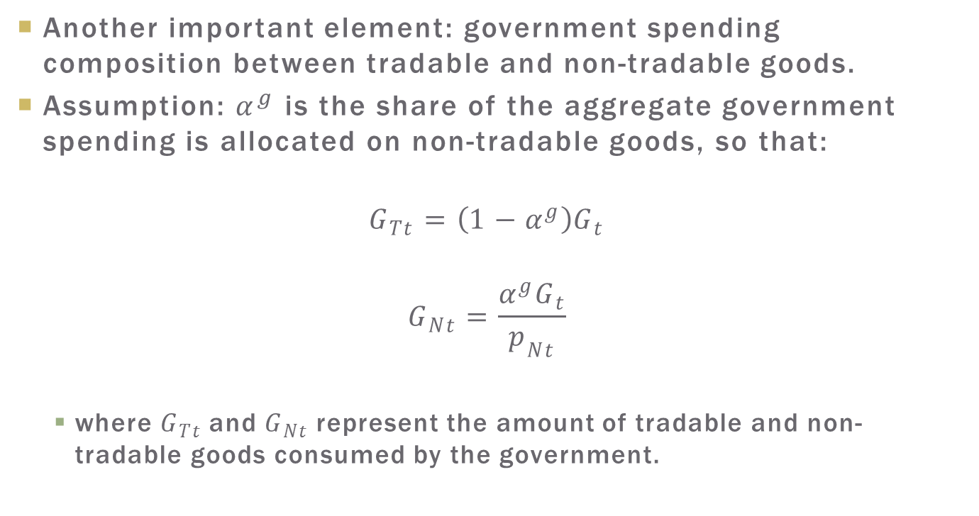
Increase in Government Spending
Another important element regarding the impact of government spending on the exchange rate is its composition between tradable and non-tradable goods. Assume that a share
of the aggregate government spending
Another important element: government spending composition between tradable and non-tradable goods.
Assumption: $α^{g}$ is the share of the aggregate government spending is allocated on non-tradable goods, so that:
$$G_{Tt}=\left(1−α^{g}\right)G_{t}$$
$$G_{Nt}=\frac{α^{g}G_{t}}{p_{Nt}}$$
  where $G_{Tt}$ and $G_{Nt}$ represent the amount of tradable and non-tradable goods consumed by the government.

Slide 62
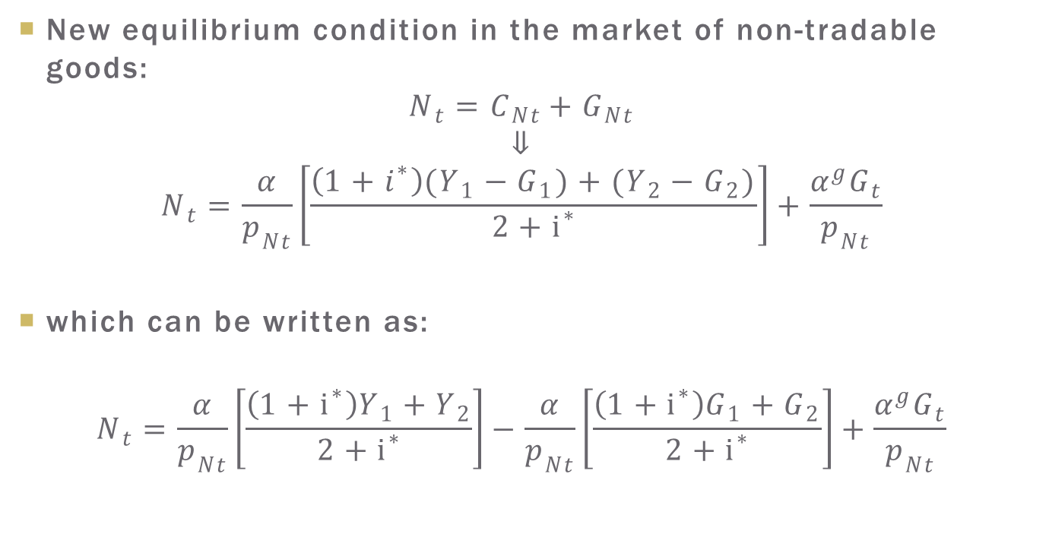
Increase in Government Spending
New equilibrium condition in the market of non-tradable goods:
$$N_{t}=C_{Nt}+G_{Nt}$$
$$⇓$$
$$N_{t}=\frac{α}{p_{Nt}}\left[\frac{\left(1+i^{∗}\right)(Y_{1}−G_{1})+(Y_{2}−G_{2})}{2+i^{∗}}\right]+\frac{α^{g}G_{t}}{p_{Nt}}$$
which can be written as:
$$N_{t}=\frac{α}{p_{Nt}}\left[\frac{\left(1+i^{∗}\right)Y_{1}+Y_{2}}{2+i^{∗}}\right]−\frac{α}{p_{Nt}}\left[\frac{\left(1+i^{∗}\right)G_{1}+G_{2}}{2+i^{∗}}\right]+\frac{α^{g}G_{t}}{p_{Nt}}$$

Slide 63

Increase in Government Spending
Intertemporal effect:
  differences between $G_{1} and G_{2}$
Compositions effect:
  differences between $α^{g}and α$
Let us look at each of them in turn.

Slide 64
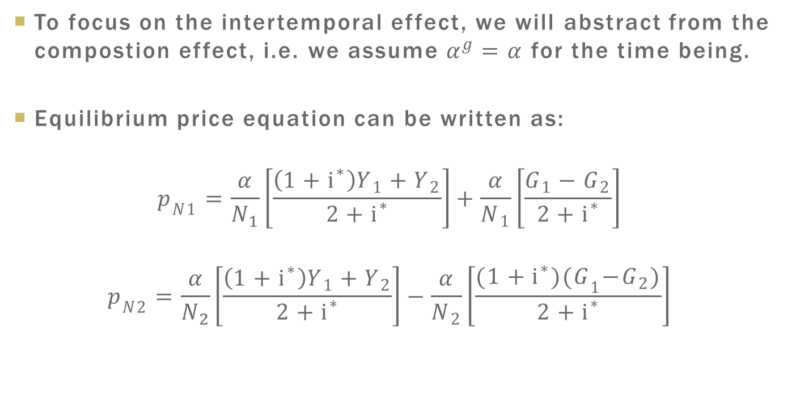
Government Spending:
Intertemporal effect
To focus on the intertemporal effect, we will abstract from the compostion effect, i.e. we assume $α^{g}=α$ for the time being.
Equilibrium price equation can be written as:
$$p_{N1}=\frac{α}{N_{1}}\left[\frac{\left(1+i^{∗}\right)Y_{1}+Y_{2}}{2+i^{∗}}\right]+\frac{α}{N_{1}}\left[\frac{G_{1}−G_{2}}{2+i^{∗}}\right]$$
$$p_{N2}=\frac{α}{N_{2}}\left[\frac{\left(1+i^{∗}\right)Y_{1}+Y_{2}}{2+i^{∗}}\right]−\frac{α}{N_{2}}\left[\frac{{(1+i^{∗})(G}_{1}−G_{2})}{2+i^{∗}}\right]$$

Slide 65
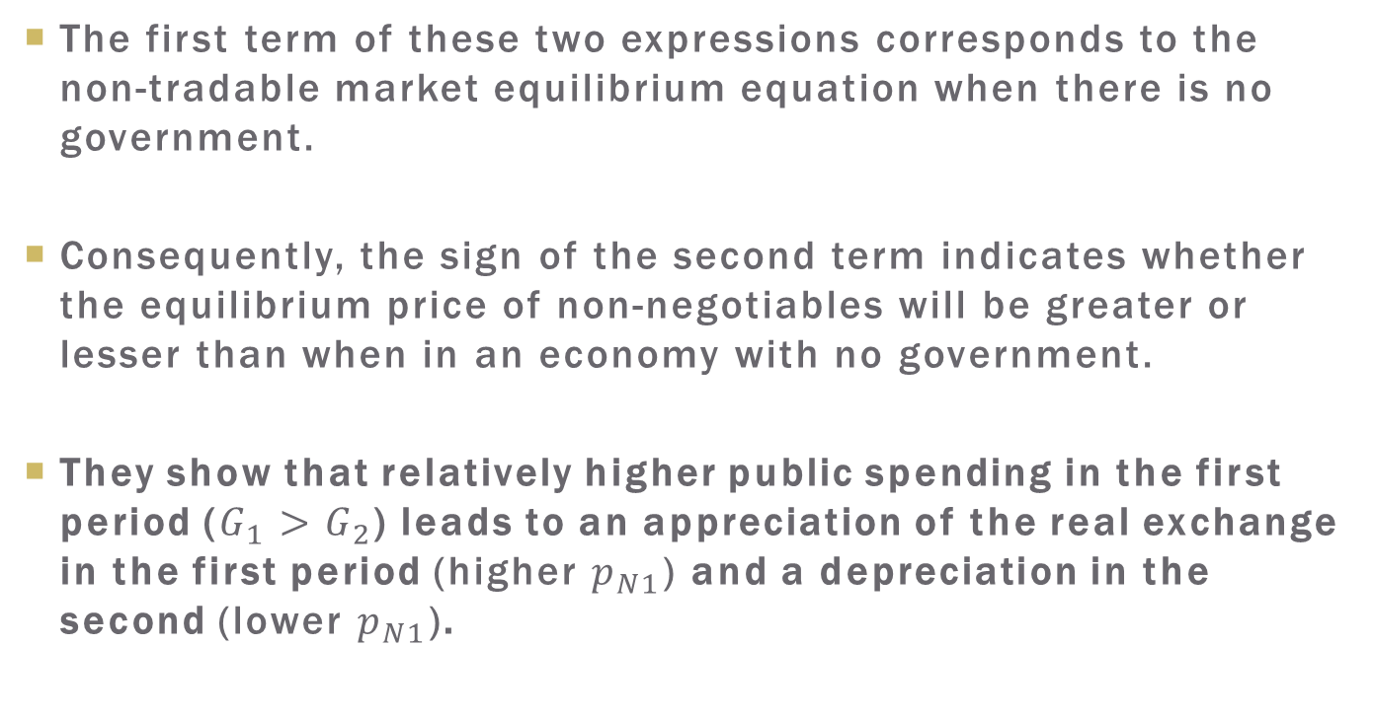
Government Spending:
Intertemporal effect
The first term of these two expressions corresponds to the non-tradable market equilibrium equation when there is no government.
Consequently, the sign of the second term indicates whether the equilibrium price of non-negotiables will be greater or lesser than when in an economy with no government.
They show that relatively higher public spending in the first period ($G_{1}>G_{2}$) leads to an appreciation of the real exchange in the first period (higher $p_{N1}$) and a depreciation in the second (lower $p_{N1}$).

Slide 66
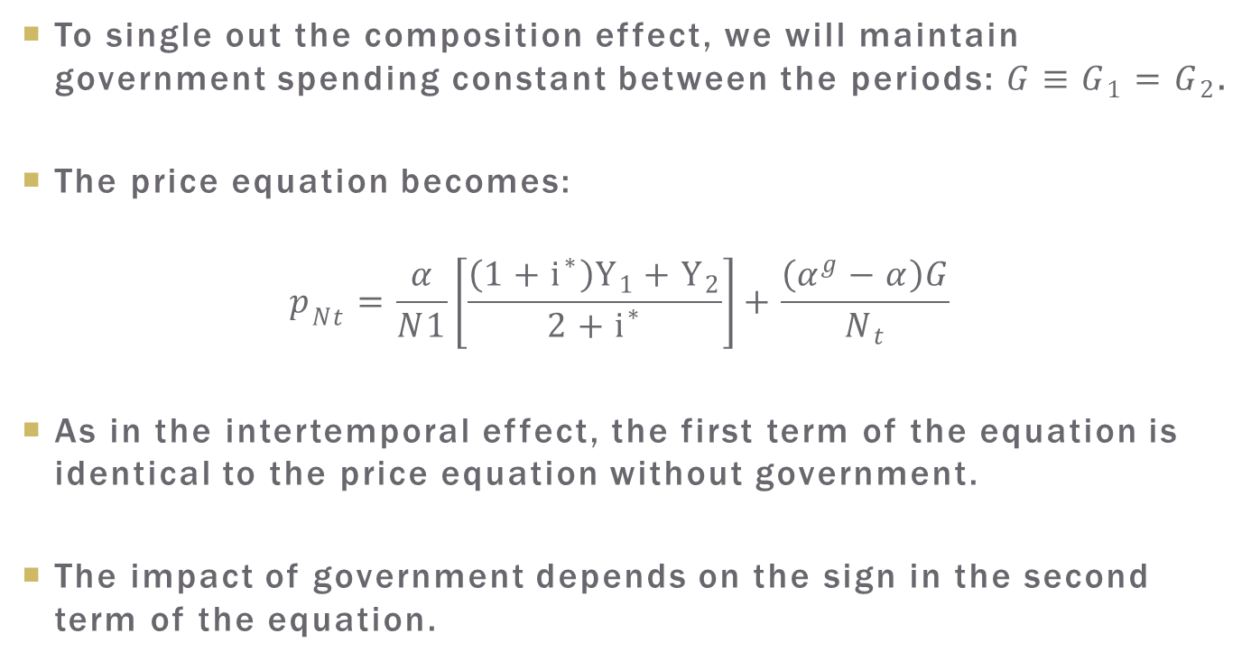
Government Spending:
Composition effect
To single out the composition effect, we will maintain government spending constant between the periods: $G≡G_{1}=G_{2}$.
The price equation becomes:
$$p_{Nt}=\frac{α}{N1}\left[\frac{\left(1+i^{∗}\right)Y_{1}+Y_{2}}{2+i^{∗}}\right]+\frac{\left(α^{g}−α\right)G}{N_{t}}$$
As in the intertemporal effect, the first term of the equation is identical to the price equation without government.
The impact of government depends on the sign in the second term of the equation.

Slide 67
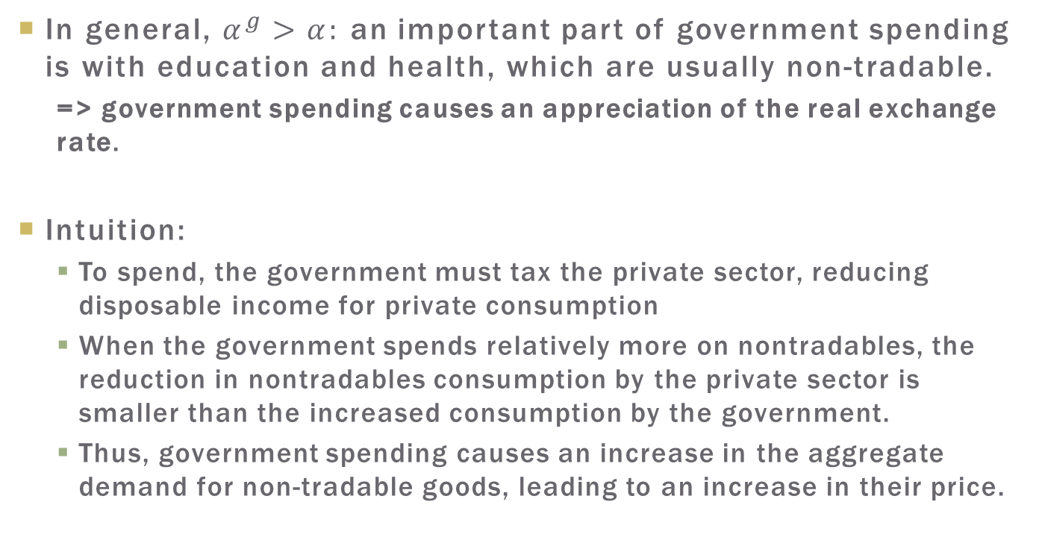
Government Spending:
Composition effect
In general, $α^{g}>α:$ an important part of government spending is with education and health, which are usually non-tradable.
  => government spending causes an appreciation of the real exchange rate.
Intuition:
  To spend, the government must tax the private sector, reducing disposable income for private consumption
  When the government spends relatively more on nontradables, the reduction in nontradables consumption by the private sector is smaller than the increased consumption by the government.
  Thus, government spending causes an increase in the aggregate demand for non-tradable goods, leading to an increase in their price.

Slide 68
Government Spending
In sum:
  higher government spending appreciates the RER, both by its intertemporal effect and by the composition effect, when a greater share of public spending is on nontradable goods.

Slide 69
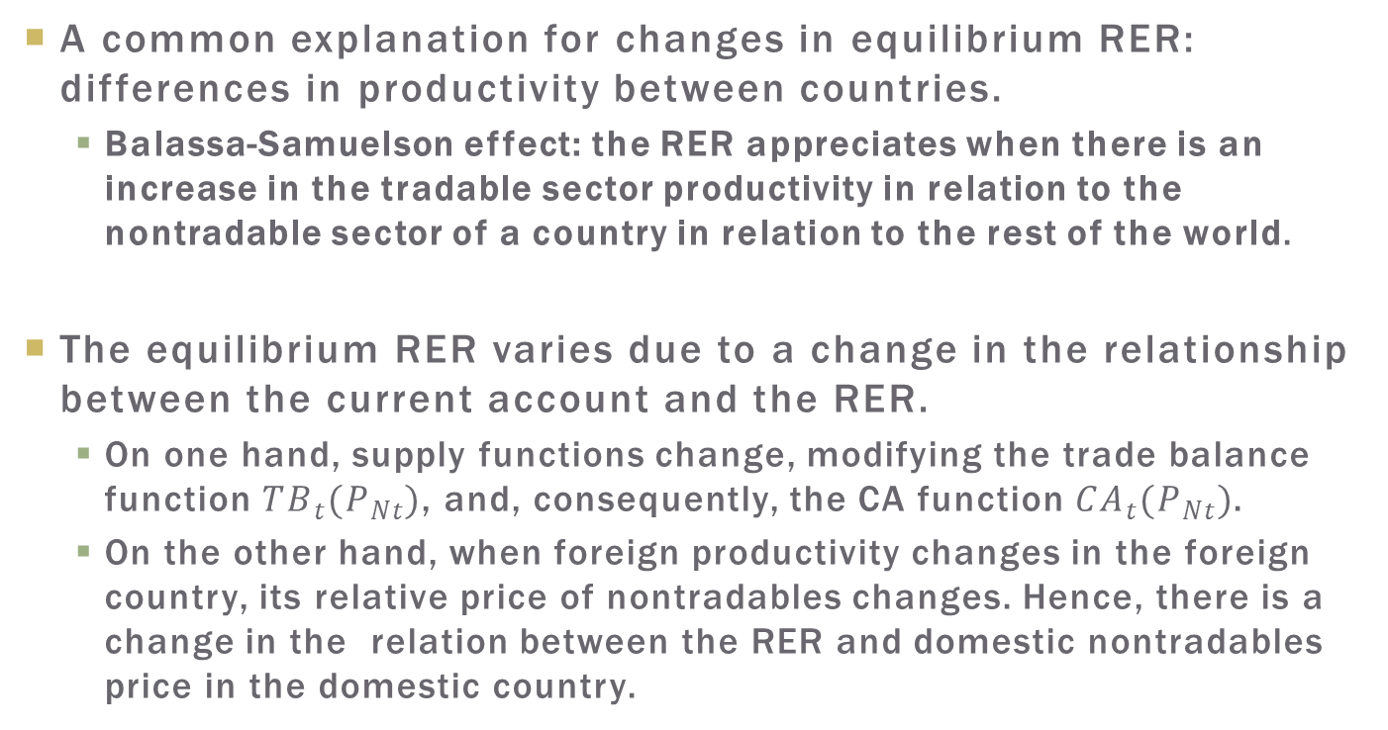
Productivity: the Balassa-Samuelson Effect
A common explanation for changes in equilibrium RER: differences in productivity between countries.
  Balassa-Samuelson effect: the RER appreciates when there is an increase in the tradable sector productivity in relation to the nontradable sector of a country in relation to the rest of the world.
The equilibrium RER varies due to a change in the relationship between the current account and the RER.
  On one hand, supply functions change, modifying the trade balance function ${TB}_{t}(P_{Nt})$, and, consequently, the CA function ${CA}_{t}(P_{Nt})$.
  On the other hand, when foreign productivity changes in the foreign country, its relative price of nontradables changes. Hence, there is a change in the relation between the RER and domestic nontradables price in the domestic country.

Slide 70
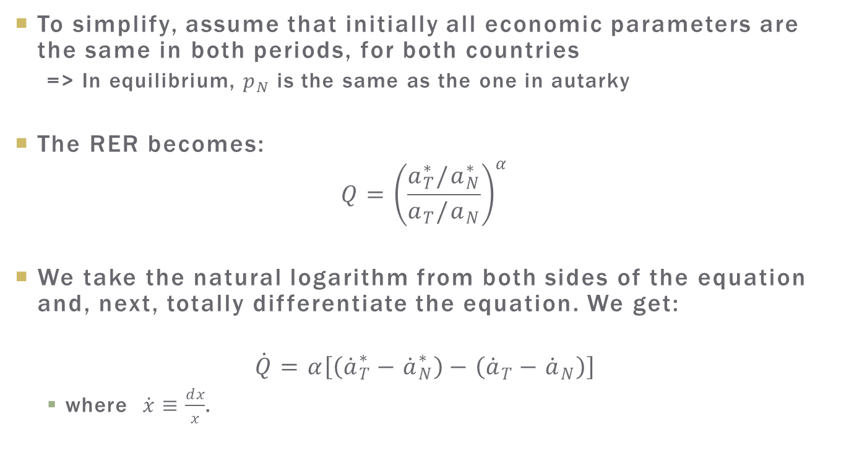
Productivity: the Balassa-Samuelson Effect
To simplify, assume that initially all economic parameters are the same in both periods, for both countries
  => In equilibrium, $p_{N}$ is the same as the one in autarky
The RER becomes:
$$Q={\left(\frac{a_{T}^{∗}/a_{N}^{∗}}{a_{T}/a_{N}}\right)}^{α}$$
We take the natural logarithm from both sides of the equation and, next, totally differentiate the equation. We get:
$$\dot{Q}=α\left[\left({\dot{a}}_{T}^{∗}−{\dot{a}}_{N}^{∗}\right)−\left({\dot{a}}_{T}−{\dot{a}}_{N}\right)\right]$$
  where $\dot{x}≡\frac{dx}{x}$.

Slide 71

Productivity: the Balassa-Samuelson Effect
Previous equation concludes that:
$$\dot{Q}<0⟺{\dot{a}}_{T}−{\dot{a}}_{N}>{\dot{a}}_{T}^{∗}−{\dot{a}}_{N}^{∗}$$
In other words, there is an appreciation of the real exchange when the increase in productivity for the tradable sector in relation to the non-tradable is greater in the home country in relation to the foreign country.

Slide 72

Dutch Disease
Exploration of new natural resources:
  a simultaneous increase of the resources endowment $\overline{Y}$ and of the productivity of the tradable goods sector $a_{T}$, (greater global production, but that is biased in favor of tradable goods).
According to the inequality in the previous slide, the increase in relative productivity of the tradable sector causes an appreciation of the RER.

Slide 73
Dutch Disease
We can think of tradable goods as a basket of goods that not only includes natural resources, but also manufactured goods.
The appreciation of the exchange rate caused by the exploration of new natural resources discourages the production of tradables in general, among them manufactured goods.
Consequently, the exploration of natural resources can lead to the de-industrialization of a country in a phenomenon known as the Dutch Disease.

Slide 74

Terms of Trade
The terms of trade is measured by the ratio between the prices of exported and imported goods.
  We must then distinguish the tradable goods between those that are exported and those that are imported.
Assumption: three goods in the economy
  exportables, importables and nontradables.
The production possibilities frontier becomes:
$${\left[{\left(\frac{X}{a_{X}}\right)}^{ρ}+{\left(\frac{M}{a_{M}}\right)}^{ρ}+{\left(\frac{N}{a_{N}}\right)}^{ρ}\right]}^{\frac{1}{ρ}}=\overline{Y}$$

Slide 75

Terms of Trade
Solving the producer problem of GDP maximization, subject to the PPF in the previous equation, we get:
$$X=\overline{Y}{\left(\frac{p_{X}a_{T}^{ρ}}{\overline{∏}(p_{N})}\right)}^{\frac{1}{ρ−1}}, M=\overline{Y}{\left(\frac{a_{T}^{ρ}}{\overline{∏}(p_{N})}\right)}^{\frac{1}{ρ−1}}, N=\overline{Y}{\left(\frac{p_{N}a_{N}^{ρ}}{\overline{∏}(p_{N})}\right)}^{\frac{1}{ρ−1}}$$
  where $\overline{Π}(p_{N})≡{\left[{\left(p_{X}a_{N}\right)}^{\frac{ρ}{ρ−1}}+a_{T}^{\frac{ρ}{ρ−1}}+{\left(p_{N}a_{N}\right)}^{\frac{ρ}{ρ−1}}\right]}^{\frac{ρ−1}{ρ}}$
  $p_{X}$: price of exportable goods
  Importable good is the numeraire => $p_{X}$ corresponds to the term of trade

Slide 76

Terms of Trade
The equilibrium price of the nontradables is now:
$$p_{Nt}=\left(\frac{α}{1−α}\right)\left[\frac{\left(1+i^{∗}\right)\left(p_{X}X_{1}+M_{1}\right)+\left(p_{X}X_{2}+M_{2}\right)}{N_{t}\left(2+i^{∗}\right)}\right]$$
Substituting the supply function into the previous equation:
$$p_{Nt}=p_{N}=\frac{{\left[{\left(p_{X}a_{N}\right)}^{\frac{ρ}{ρ−1}}+{\left(a_{M}\right)}^{\frac{ρ−1}{ρ}}\right]}^{\frac{ρ−1}{ρ}}}{a_{N}}{\left(\frac{α}{1−α}\right)}^{\frac{ρ−1}{ρ}}$$
  assuming that the PPF parameters do not change over time,

Slide 77

Terms of Trade
To simplify, let us assume there are only two countries: the home country and the foreign, with identical consumers, but they differing with respect to the productivity parameters.
In the foreign country, the price of non-tradables is given by:
$$p_{N}^{∗}=\frac{{\left[{\left(p_{X}a\right)}^{\frac{ρ}{ρ−1}}+{\left(a_{M}^{∗}\right)}^{\frac{ρ−1}{ρ}}\right]}^{\frac{ρ−1}{ρ}}}{a_{N}^{∗}}{\left(\frac{α}{1−α}\right)}^{\frac{ρ−1}{ρ}}$$
  Notice that in the foreign country, good X is imported, and good M is exported.

Slide 78

Terms of Trade
For the home country to export good X and import good M, it needs to have a comparative advantage in the production of good X:
  its production of X should be relatively greater than the production of M in relation to the foreign country.
Stated differently, it is necessary that:
$$\frac{a_{X}}{a_{M}}>\frac{a_{X}^{∗}}{a_{M}^{∗}}$$
  As we will see, this relation is essential to identify the effect of terms of trade variations on the RER.

Slide 79

Terms of Trade
The price index now includes three goods:
$$P=p_{N}^{α}p_{X}^{α_{X}}$$
  $α_{X}$: the share of expenditures spent on exportable goods.
The RER will then be:
$$Q=\frac{p_{N}^{∗α}p_{X}^{α_{X}}}{p_{N}^{α}p_{X}^{α_{X}}}={\left(\frac{p_{N}^{∗}}{p_{N}}\right)}^{α}$$
  where we assume that $S=1$.

Slide 80

Terms of Trade
Substituting the prices of non-tradables in the two countries into the RER, we have that:
$$Q={\left[\frac{{\left(p_{X}a_{X}^{∗}\right)}^{\frac{ρ}{ρ−1}}+1}{{\left(p_{X}a_{X}\right)}^{\frac{ρ}{ρ−1}}+1}\right]}^{\frac{ρ−1}{ρ}}\frac{a_{M}a_{N}}{a_{M}^{∗}a_{N}^{∗}}$$
Given the comparative advantage pattern, a permanent increase in the terms of trade, $p_{x}$, causes an appreciation of the RER: $\frac{∂Q}{∂x}<0$.
Intuition:
  an improvement in the TOT = an increase in the real income for the country.
  Higher income => more consumption => higher relative price of nontradables to rebalance the market of this good.

Slide 81
Terms of Trade
We have analyzed the impact of a permanent TOT change
  => No change in the affect the relative disposable income between the two periods, so no impact on the CA balance.
The exchange rate appreciation occurs because the terms of trade alters the relation between the CA and the RER.
  An improvement in the TOT increase the trade balance for a given RER.
  Hence, to maintain the trade balance and, consequently, a constant CA, there should be an appreciation of the RER.

Slide 82
Terms of Trade
Temporary changes in the terms of trade would, therefore, have, an additional impact on the equilibrium CA level.
  TOT improvement = higher domestic purchasing power.
  If the improvement is temporary, the effect on the current account is equivalent to a positive and temporary income shock: it causes an increase in the current-account balance.
  Greater CA balances are associated with a more depreciated exchange, in this way mitigating the appreciation resulting from the direct impact on relative prices previously discussed.

